Slide 1
Project Garnet Urban Renewal Plan
Colorado Springs City Council
Work Session
January 23, 2023
Jariah Walker
CSURA Executive Director
Bob Cope
Economic Development Officer

Slide 2
Presentation Overview
Project Garnet Overview
Urban Renewal Designation
Economic and Fiscal Impact Analyses
Staff Recommendation
Questions

Slide 3
Project Garnet Overview
Entegris, Inc. is a global supplier of advanced materials and process solutions for the semiconductor, life sciences, and other high-tech industries.

Slide 4
Project Garnet Overview
Publicly Traded on Nasdaq
Trading Symbol: ENTG
Market Capitalization: $17 Billion

Slide 5
Project Garnet Overview
Entegris Manufacturing Center of Excellence
Investment plans for expansion and job creation
$631 million capital investment over 5 years
$ 280 million building and improvements
$351 million machinery, equipment, furniture and fixtures
Construct approximately 500,000 Sq. Ft. Facility
597 jobs over 5 years
Average wage: $75,754
Colorado Springs competed with other communities for this project – Highly competitive

Slide 6
Project Garnet Overview
Potential for significant Phase 2 expansion in 2028
$554 million capital expenditure
500,000 Sq. Ft. expansion
483 new jobs
(This analysis models phase 1 only)

Slide 7
Project Garnet Overview
Proposed Site
301 South Rockrimmon Boulevard
Approximately 88 acres
Appropriately zoned
Site was previous location of Compaq Computer Corporation manufacturing facility
The facility was demolished in 2012

Slide 8
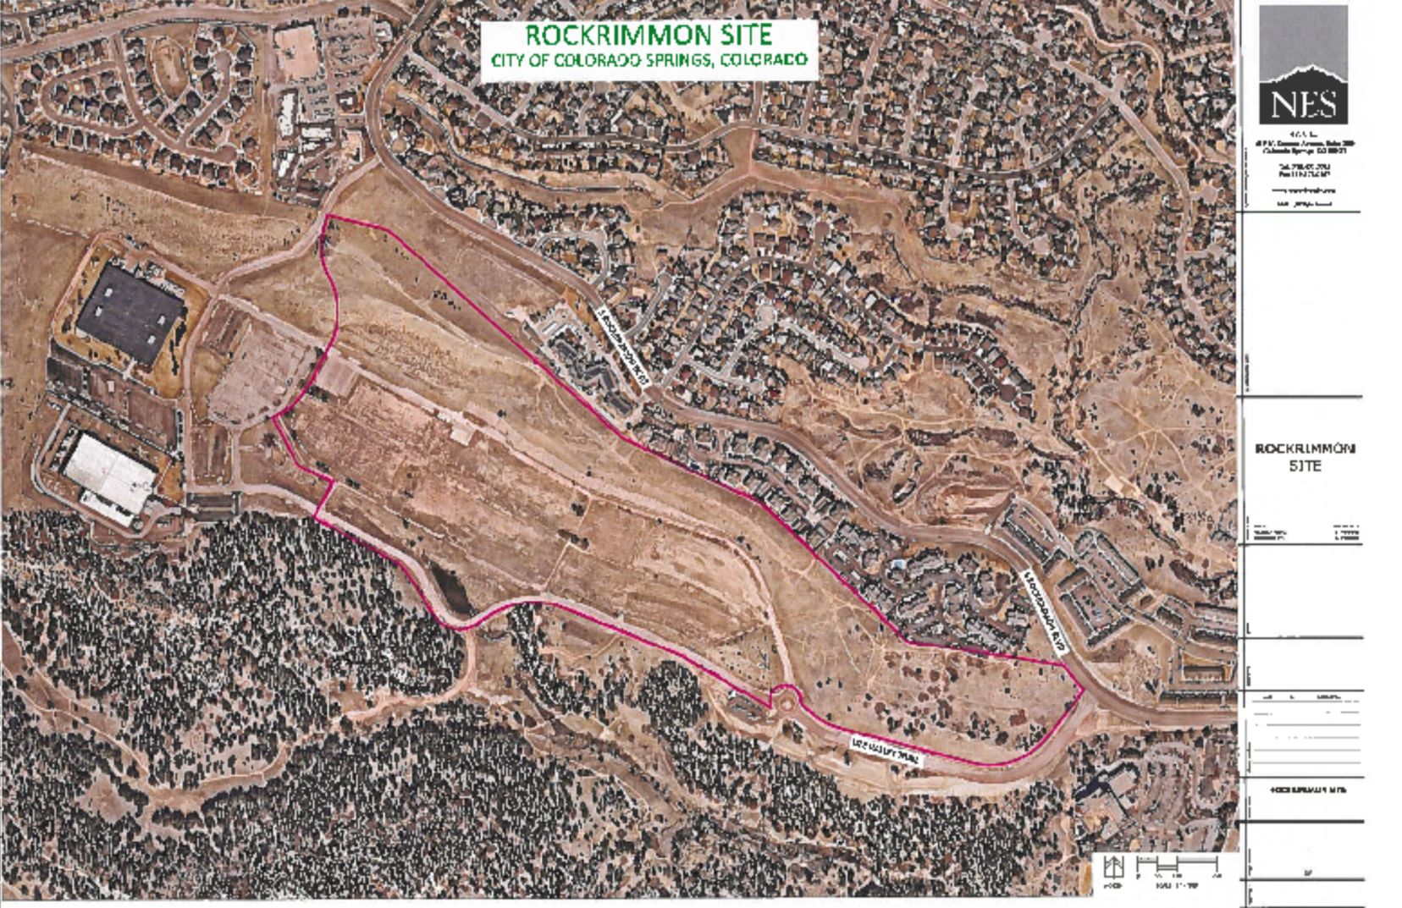
Project Garnet Overview

Slide 9
Project Garnet Overview
Incentives through an EDA from the City of Colorado Springs
Additional incentives from the State of Colorado, El Paso County and Colorado Springs Utilities.
Chamber & EDC Deal Closing Fund
Project Garnet is pursuing an Urban Renewal designation
Company will break ground on the new facility in 2023 following final approval of local and state incentives.

Slide 10
URA Designation
URA designation to address statutory blight
To facilitate an extraordinary investment, job creation and economic growth
To make Colorado Springs competitive with other cities under consideration

Slide 11
URA Designation
Existing Conditions Survey
Urban Renewal Plan
El Paso County Impact Report

Slide 12
Economic & Fiscal Impact Analysis
Expansion
15-Year Economic and Fiscal Impact Analyses

Slide 13
Expansion: Economic Impact
15-Year Analysis of New Community Benefits from Expansion
New Community Benefits – Permanent Jobs | 15 Year Total
Direct Jobs | 631
Indirect/Induced Jobs | 583
Total Permanent Jobs | 1,214
New Community Benefits – Construction Jobs
Total Construction Jobs | 4,268
New Community Benefits – GMP | 15 Year Total | Average Annual
Total Value Added (Gross Metropolitan Product) | $2.2 Billion | $148 Million

Slide 14
Expansion: Fiscal Impact
15-Year Analysis of Gross New City Revenue from Expansion
*No Sunset
New City Revenue from Expansion | 15 Year Total | Average Annual
Total New City Revenue (Gross) | $54,693,919 | $3,646,270
* Indicates item scheduled to sunset; calculations assume special fund taxes are renewed after sunset.
* See Appendix slide 23 for breakdown of calculations.

Slide 15
Expansion: Calculation of Incentives
Calculation of Incentives for Expansion: City Sales and Use Tax Rebates over a 15-Year EDA Agreement
City Sales and Use Tax Rebate | Total
Business Personal Property (Machinery and Equipment) | $5,265,000
Construction Materials | $1,400,000
Total Estimated Sales and Use Tax Rebate | $6,665,000

Slide 16
Expansion: Fiscal Impact
15-Year Analysis of Net New City Revenue from Expansion
*No Sunset
New City Revenue from Expansion | 15 Year Total | Average Annual
Total New City Revenue (Gross) | $54,693,919 | $3,646,270
City Incentive | ($6,665,000) | ($444,333)
Total New City Revenue (Net) | $48,028,919 | $3,201,937

Slide 17
Staff Recommendation
Approval of a resolution making certain legislative findings and approving the Project Garnet Urban Renewal Plan.
AND
Approval of a resolution approving a Cooperation Agreement between the Colorado Springs Urban Renewal Authority and the City of Colorado Springs to promote redevelopment and assist with financing of public improvements for the Project Garnet project pursuant to Colorado Revised Statute Section 31-25-107(9)(a)(II)

Slide 18
Questions?

