Slide 1
+
We empower people to thrive

Slide 2
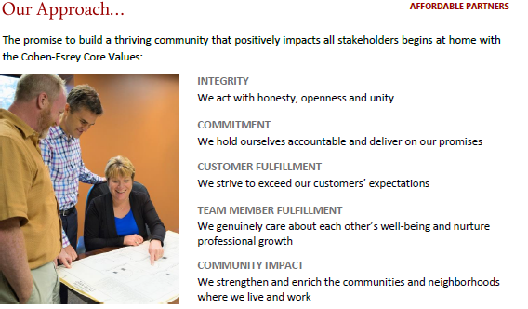
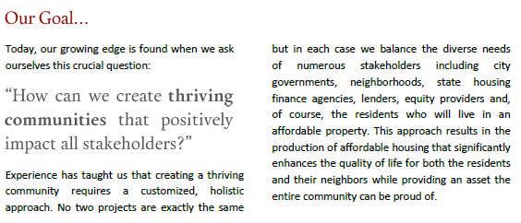
Cohen-Esrey Development Group
Founded in 1969 in Kansas City
Over the last 20 years, CEDG has developed 3,000 affordable housing units across the nation.
Recent Awards:
Top 50 Affordable Housing Developers, Affordable Housing Finance, 2017
Nebraska Preservation Award, History Nebraska, 2018
Residential Development that Overcame Significant Obstacles Award, Novogradac, 2019
AD Astra Award, KHRC, 2015
2020 Ken Kringle award for historic redevelopment in Dubuque, IA (Marquette Hall)

Slide 3
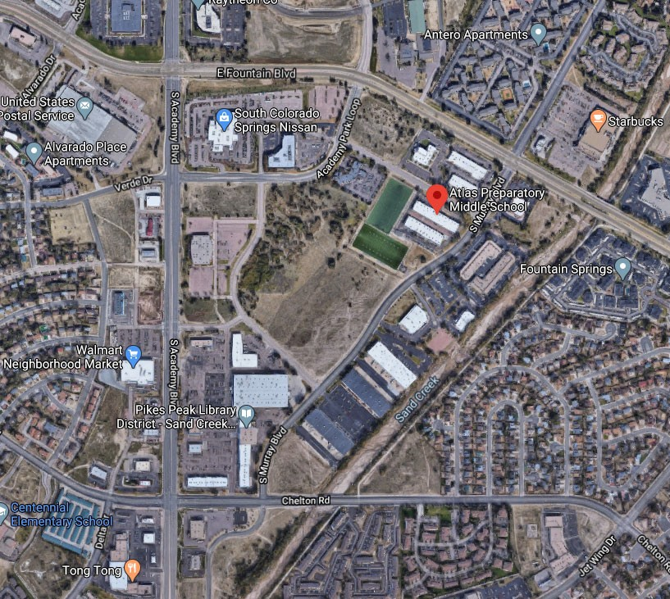
ZEBULON FLATS – 138 Affordable Apartment Homes

Slide 4
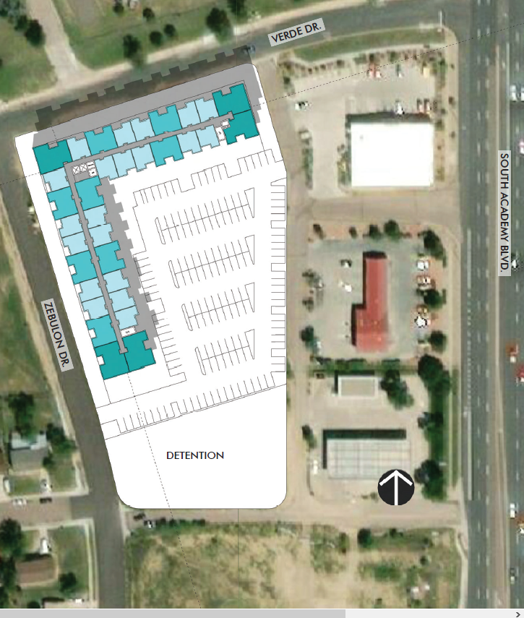
We plan to have the units facing west to optimize the views.
To add sidewalks, street lighting, streetscape and public art. (maybe with Knobhill Urban Arts District, Pikes Peak Arts Council, Centennial Elementary, Carmel Middle or Sierra HS)
The area marked Detention will not need to be quite that large. We expect to have area for a kids play area, BBQ/Picnic, Bike Storage & a Dog Run
On the first floor we will have a community room we plan to offer for community meetings/gatherings, after school tutoring for kids, Job Fairs & employment outreach

Slide 5
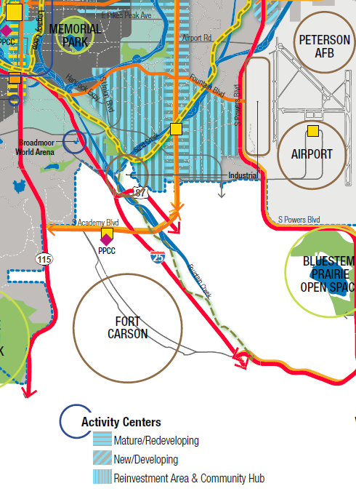
PUBLIC IMPROVEMENTS
COMPREHENSIVE PLAN & PlanCOS
The proposed site is located at 1609 Zebulon/3725 Verde Drive in the Valley Hi neighborhood. Per the PlanCOS map this area has been identified as a special focus mature/redevelopment area. In addition neighborhood planning and attainable housing are specifically listed as a major initiative in the Plan COS Alignment.
Zebulon Flats will contribute to both of these initiatives through the construction of a $38 million multi-family community and the corresponding benefits of construction/consulting jobs, MBE/WBE outreach, employment opportunity for local neighborhood, and sales tax revenue from both the construction of the project and the 138 families that will live there.
Art
Community Room
100% Affordable Housing
Sidewalks & Streetscape
Well Lit Walkways – possibly a new streetlight
Security Cameras
Landscaping

Slide 6
Source: HomeCOS, Housing Our Future, the City of Colorado Springs Affordable & Attainable Housing Plan

Slide 7
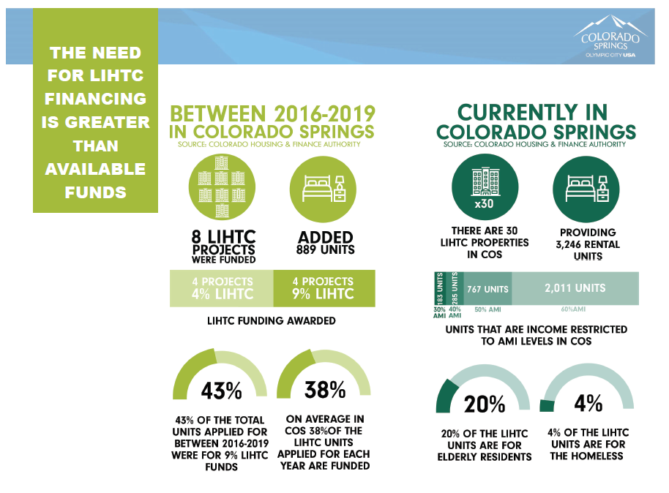
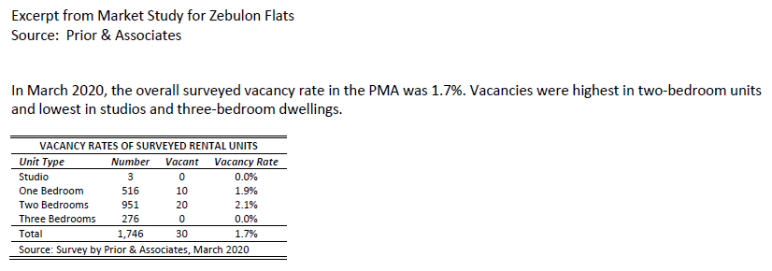
Source: HomeCOS, Housing Our Future, the City of Colorado Springs Affordable & Attainable Housing Plan

Slide 8
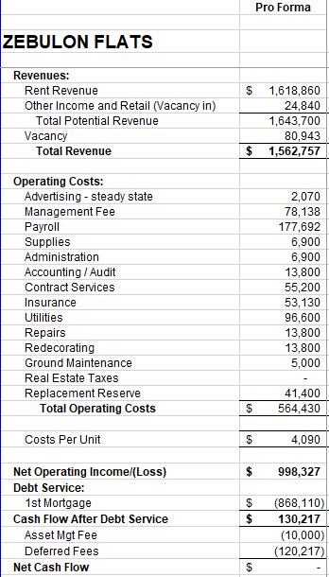
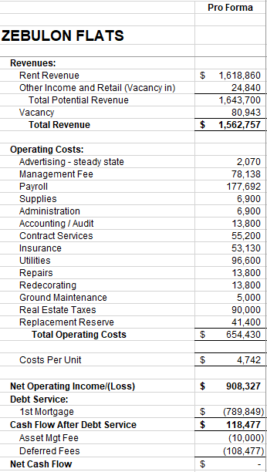
No Property Tax
With Property Tax
W
H
Y
T
I
F
?
How does this translate into our capital stack ?

Slide 9
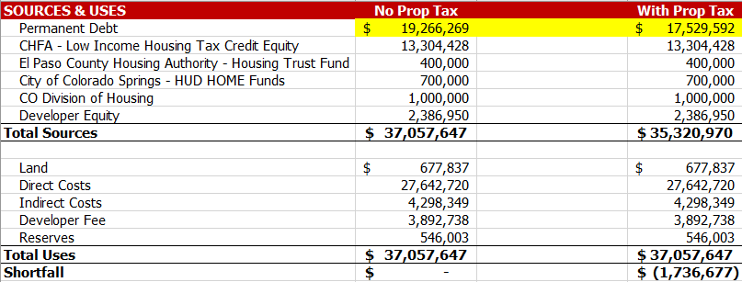
The $90,000 reduced property tax translates into $90,000 of increased Net Operating Income which translates into $1,736,677 of increased loan proceeds.
CO Springs HA does provide a partial Property Tax exemption which isn’t sufficient to make this this project feasible. Here is language from their policy:
The CSHA fee typically involves a negotiated up-front fee and an annual fee equivalent to 35% to 40% of the property tax obligation for the duration of the partnership. An “accelerator” clause must also allow for the fee to include future increases in the tax assessment for the property.

Slide 10
COMMUNITY
INVOLVEMENT
We want to be a community partner in addition to providing housing. We want to provide a place to meet, gather, and connect people to the community through jobs, social networking and empowering people to be self-sufficient by providing housing as the cornerstone.

Slide 11
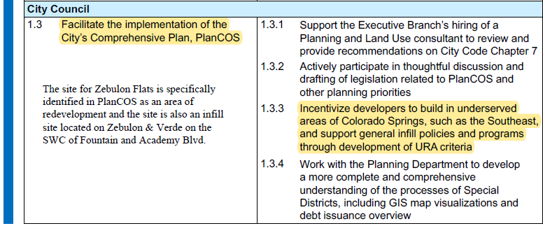
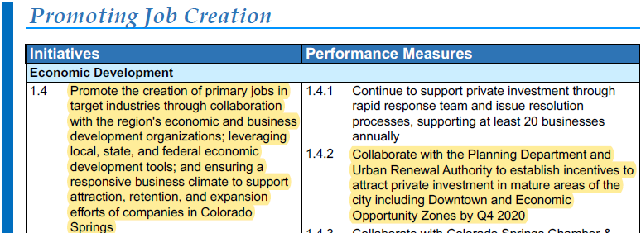
Source: 2020 City of CO Springs Budget – City Council Strategic Plan

Slide 12
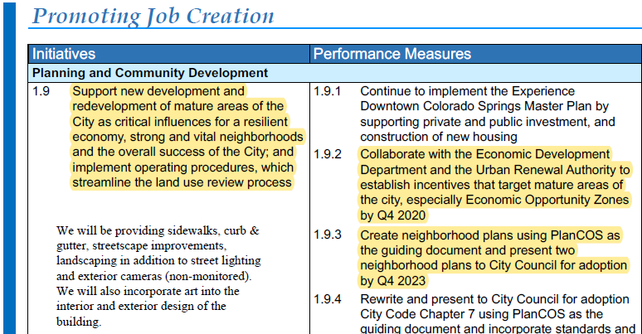
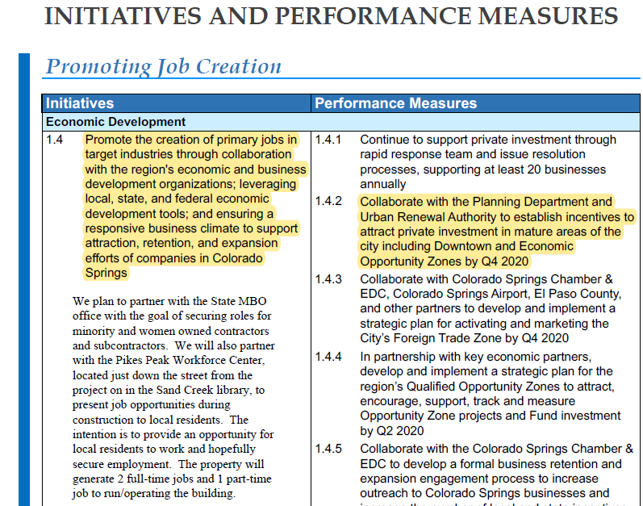

Slide 13
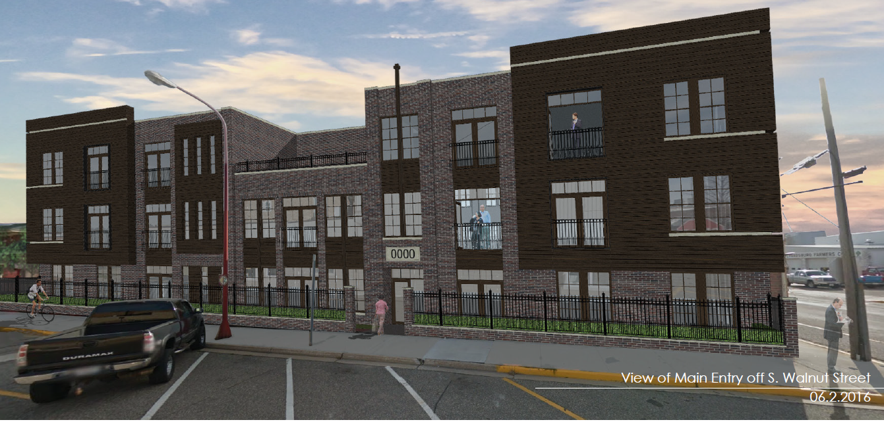
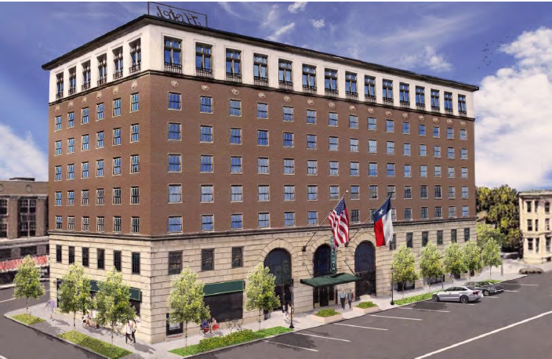
The project in Reedsburg, WI is in the process of leasing up and we have set aside 14 units for disabled residents with 6 of those units having priority for veterans.

