Slide 1
Downtown Shuttle

Slide 2
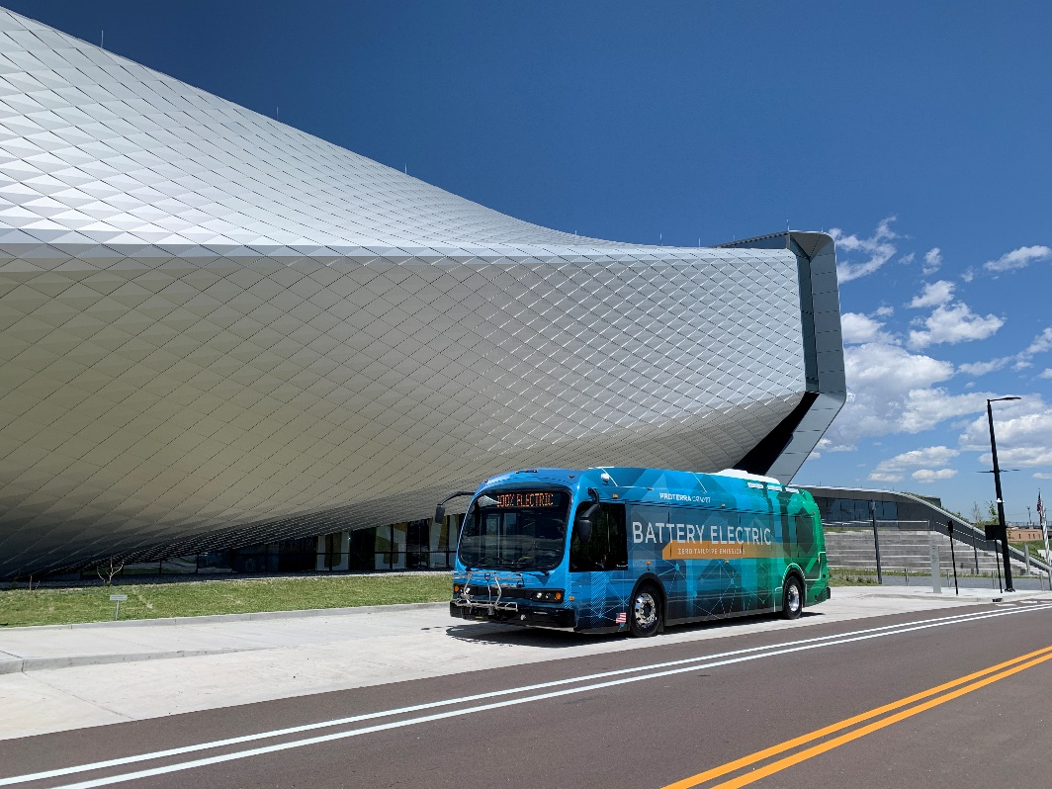
Downtown Shuttle
Fare-free bus service on Tejon Street
Easy connection to shops, restaurants, sporting and entertainment venues, downtown apartments and hotels
7 days a week service

Slide 3
Need
Downtown Shuttle Analysis completed in 2019
As Downtown grows, a high frequency bus service will
  Alleviate traffic congestion
  Assist with parking management
  Increase foot traffic for businesses
  Connect downtown residents to various services and businesses
  Assist in sustainable growth downtown

Slide 4
Service Details
Monday – Thursday:
  6 am – 6 pm (7 min)
  6 pm – 10 pm (10 min)
Friday:
  6 am – 6 pm (7 min)
  6 pm – 2 am (10 min)
Saturday:
  8 am – 2 am (10 min)
Sunday:
  10 am – 8 pm (10 min)

Slide 5
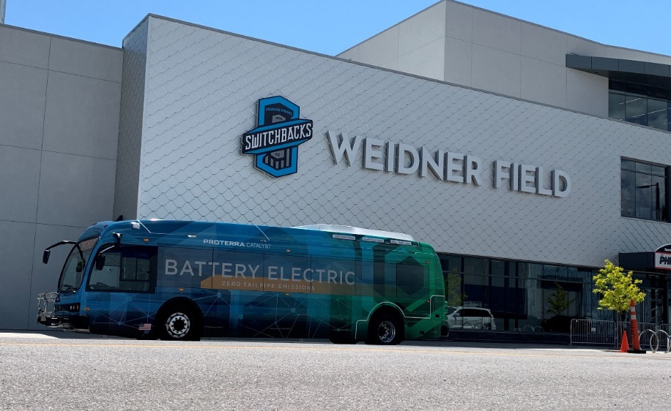
Proposed Stops
  Rio Grande St – Between Cascade and Sahwatch Street
  S. Sierra Madre
    W. Moreno St.
    W. Costilla St. Costilla
  Tejon Street
    W. Moreno St.
    E. Vermijo St.
    E. Colorado St.
    E. Platte Ave.
    E. Willamette Ave.
    E. Dale St.
  N. Nevada St.
    E. Cache La Poudre St. (existing bus stop)
  Future Stop(s)
    W. Costilla St between Sahwatch St. and S. Cascade

Slide 6
Proposed Stop Locations

Slide 7
Program Implementation Plan
Tiered approach
  Tier 1: Implement shuttle service by Spring 2022
  Tier 2: Replace Tier 1 diesel us with electric buses (EV)
  Tier 3: Upgrade Tier 2 EV buses and/or integrate new transportation technology
Notes:
Breaking ground. Explain what breaking ground means for this project
- Phase 1. Implement the Shuttle service by spring 2022 using six new 30-foot, low-floor, diesel-powered buses (diesel buses) through an existing contract. These buses can be integrated into the existing bus fleet and replace other diesel buses in the future. The EZ10 autonomous shuttle may supplement the Shuttle if appropriate infrastructure and regulatory approvals can be obtained.
- Phase 2. Replace Tier 1 diesel buses with six new 30-foot, low-floor, electric-powered buses (EV buses) procured with funding assistance from competitive grants. Repurpose the diesel buses as replacement vehicles to the existing transit fleet inventory.
- Phase 3. Upgrade Tier 2 EV buses and/or integrate new transportation technology, such as connected vehicle technology, into the Shuttle. Tier 1 may also be supplemented with an EZ10 autonomous shuttle if appropriate infrastructure and regulatory approvals can be obtained.

Slide 8

Public Safety
DTS will enhance and improve public safety, with less people driving around looking for a parking space which will make it safer for pedestrians
Less cars downtown means less congestion, hence improved air quality
Downtown employees can take the shuttle and keep their cars in a safe and secure location

Slide 9
Noise and Pollution Concerns?
The Downtown Partnership does daily cleanup so cleanliness will be of utmost importance
The buses are quiet, and eliminate the need to have dozens of cars downtown so traffic as well as noise and pollution levels will decrease

Slide 10
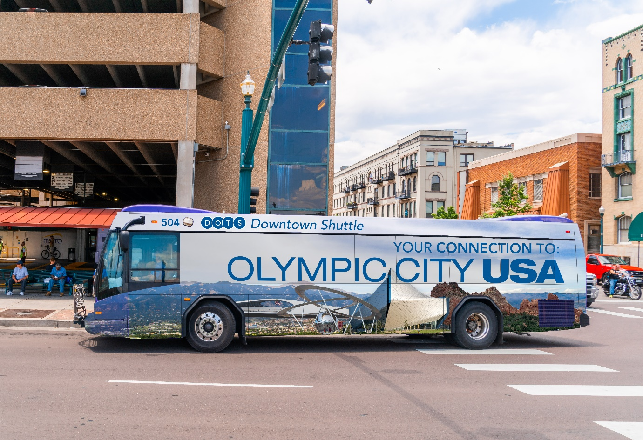
Questions?
Thank you for your time!
Notes:
Please note, the wrap on this bus is only a proposed design idea at the moment.

