Slide 1
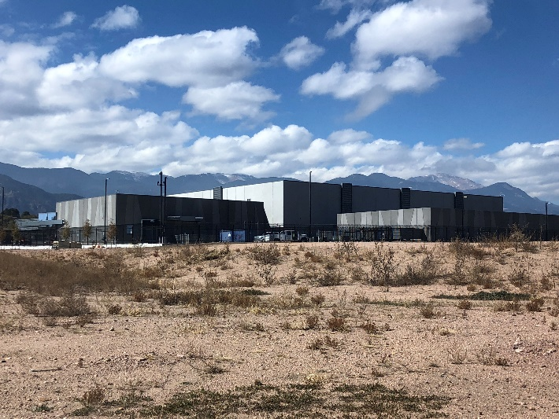
PRESENTATIONFOR
Colorado Springs Urban Renewal Authority
status of development progress
Vineyards Data Center Campus
November 2022

Slide 2
DEVELOPMENTUPDATE
In October of 2021, we entered into Purchase and Sale Agreement with Falcon Data Centers who intended to purchase and develop the remaining acreage.
In December, FDC exercised their right to terminate

Slide 3
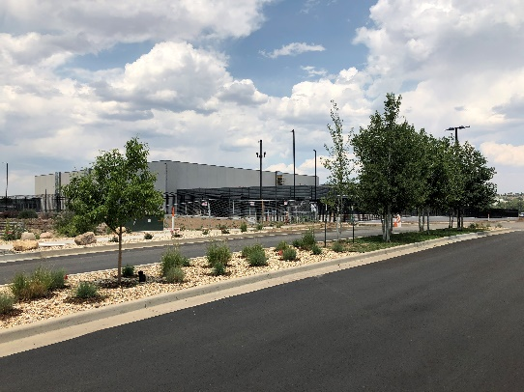
DEVELOPMENTUPDATE
In October of 2022, we entered into a new Purchase and Sale Agreement with FDC who intends to purchase and develop the remaining acreage. This time, they have multiple users in place to initiate immediate development activity with a goal of beginning initial development in early Q2, 2023.
Closing anticipated by not later than December 27, 2022.

Slide 4
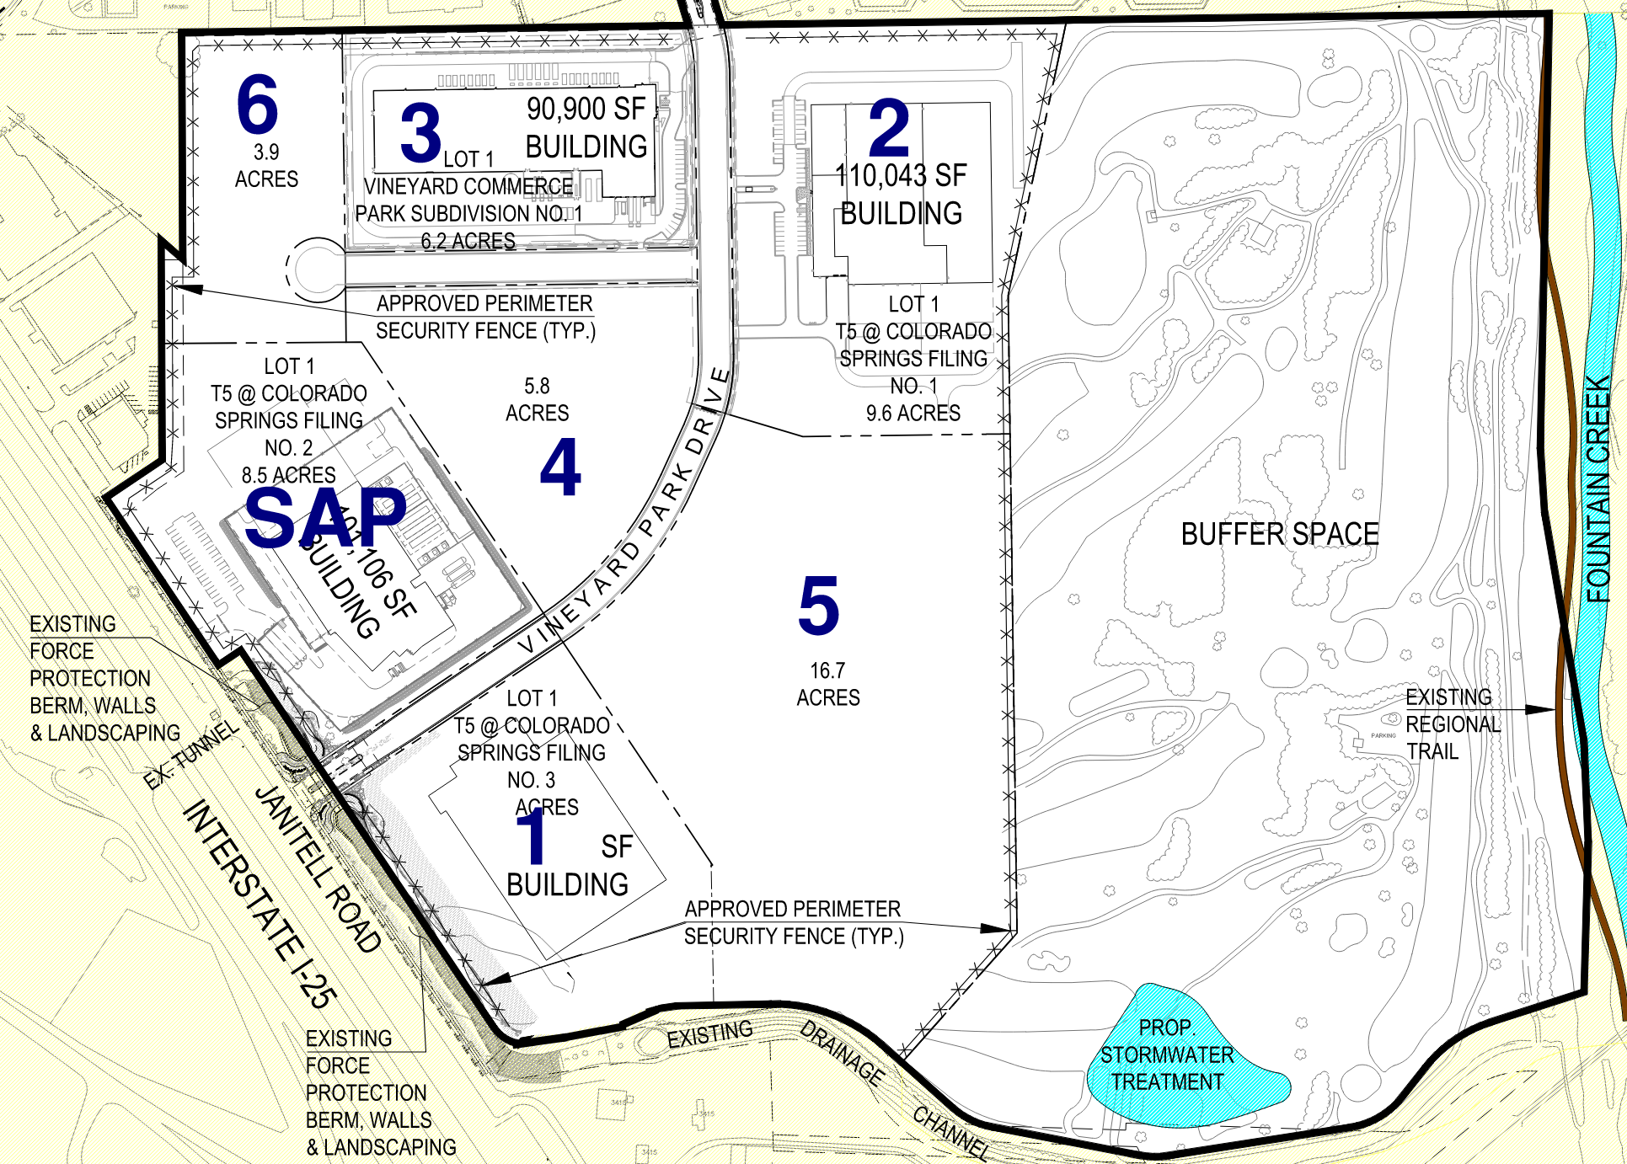
BUSINESSPLAN
Multi-phased development planned beginning with Building One. Development Plan approvals in place for parcels 1, 2 and 3.
Building One
73,000 sf
Delivery in Q1 2024
1
Building Two
110,000 sf
Delivery in Q1 2025
2
Building Three
91,000 sf
Delivery in Q1 2026
3
Building Four
65,000 sf
Delivery in Q1 2027
4
Building Five
150,000 sf
Delivery in Q1 2028
5
Building Six
43,000 sf
Delivery in Q1 2029
6

Slide 5
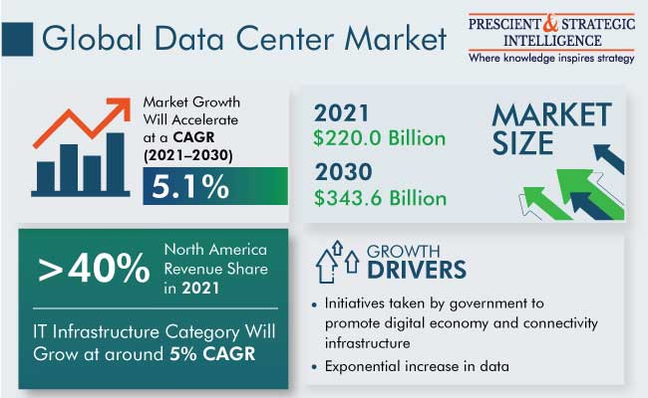
MARKETTRENDS
Market Overview
The global data center market size was valued at $187.35 billion in 2020 and is estimated to be valued at $220.0 billion by 2022. This market number is expected to increase with a CAGR of 5.1%, to reach $343.6 billion in 2030.

Slide 6
MARKETTRENDS
The rapidly increasing data generation is one of the major factors for the growth of the data center market. In 2021, 64.2 zettabytes of data was created, which was a 314% increase from 2015. Industry experts predict that by 2025, nearly 10 times more data will be generated than that produced in 2017. Moreover, around 2.5 quintillion bytes of data is being generated every day, globally. With the advent of IoT and the high adoption of social media platforms, approximately 90% of the data in the world was produced within the past four to five years.

Slide 7
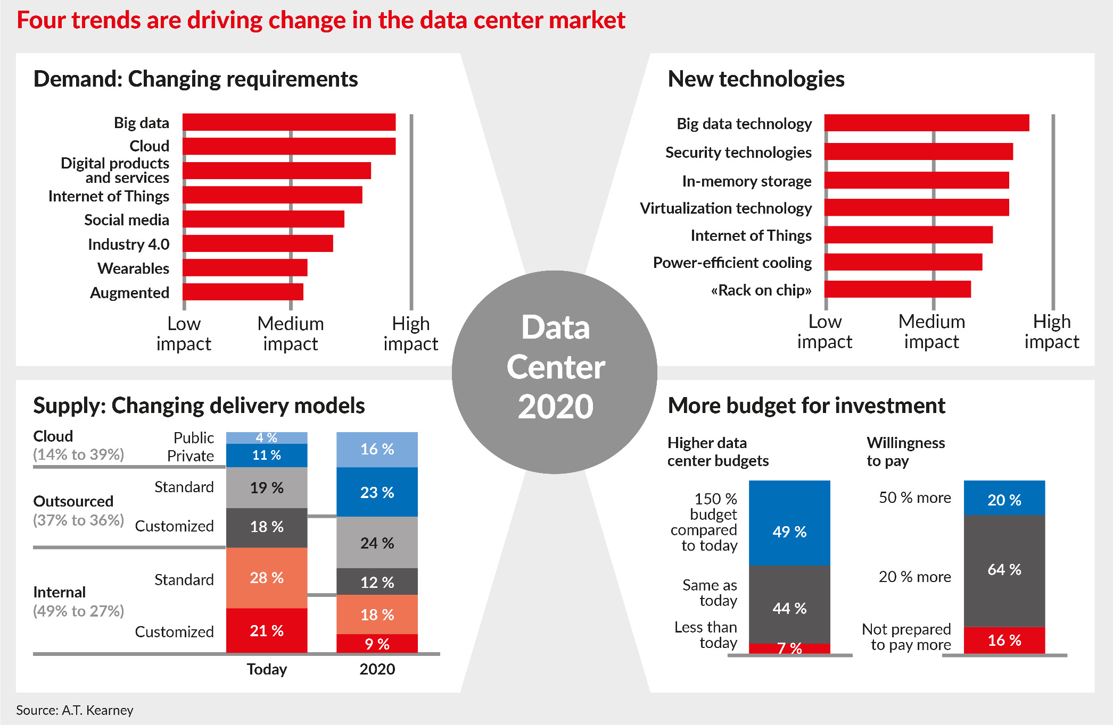
MARKETTRENDS

