Slide 1




Partner Entity Update
October 24, 2018
Carl Schueler, Comprehensive Planning Manager
Urban Renewal Board

Slide 2
Tentative Schedule
September
SC
Meeting
Oct – Nov
PC
Presentations
Nov – Dec
CC
Work Sessions
SC
PWG
CC/PC
Public
Staff
January
CC Hearings
Notes:
Verbally mention the board and commission updates and endorsements in October

Slide 3

Plan organization
PlanCOS will have 6 vision theme chapters
  Vibrant Neighborhoods (Chapter 2)
  Unique Places (Chapter 3)
  Thriving Economy (Chapter 4)
  Strong Connections (Chapter 5)
  Renowned Culture
    (Chapter 6)
  Majestic Landscapes
    (Chapter 7)
PlanCOS will primarily be an online plan.
Notes:
(unable to predict the demand and technology)

Slide 4
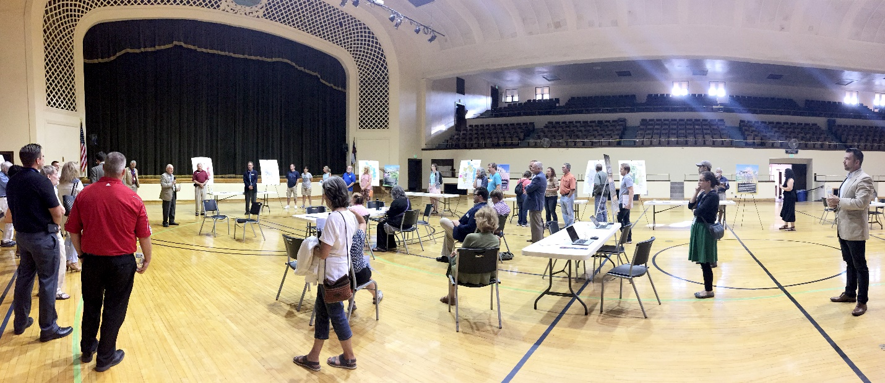
Core Chapter Organization
Core Chapter Organization
  Importance Statement - Key Trends & Assumptions
  Several “Typologies” - Relevant Plans
  Framework Map - Essential Questions
  Goals, Policies, and Strategies
PlanCOS Open House (July 12, 2018)
Notes:
(unable to predict the demand and technology)

Slide 5
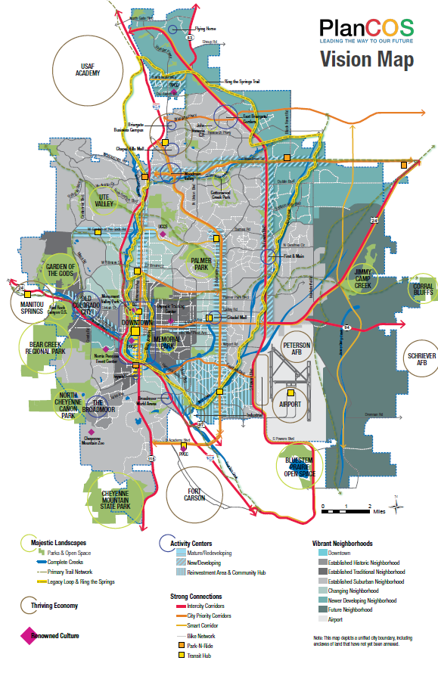
Vision
Map
Revised to appear less Downtown centric

Slide 6
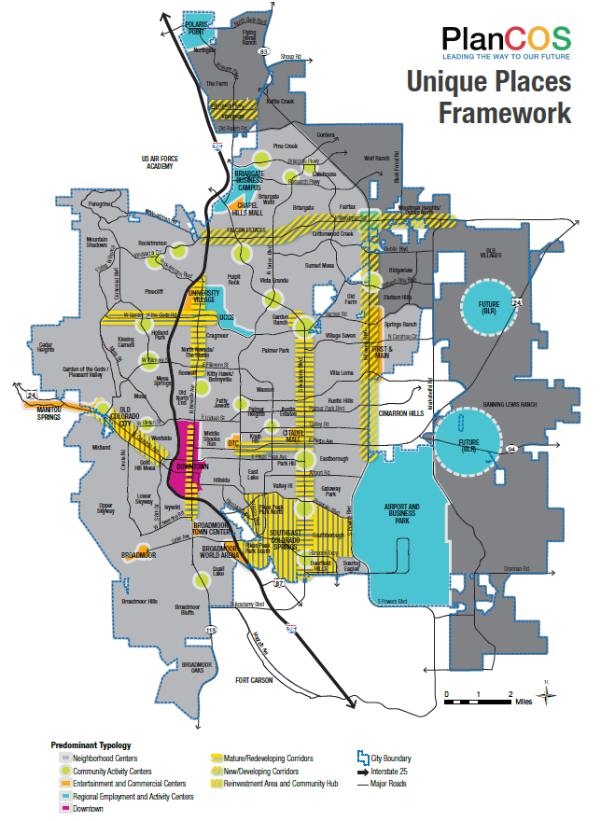
Unique Places
Framework Map
Revised as of 9.24.18

Slide 7
Unique Places (Ch. 3)
Big Ideas/Goals:
Grow the City’s Heart
Focus on Corridors and Centers
Embrace Creative Infill Adaptation and Land Use Change
Notes:
(unable to predict the demand and technology)

Slide 8
Downtown vision
Unique Places (Chapter 3) Vision
  Centers on a vibrant Downtown and is strengthened by our investment in walkable, healthy, and magnetic activity centers that are located in new and reinvented areas throughout our city.
Notes:
(unable to predict the demand and technology)

Slide 9
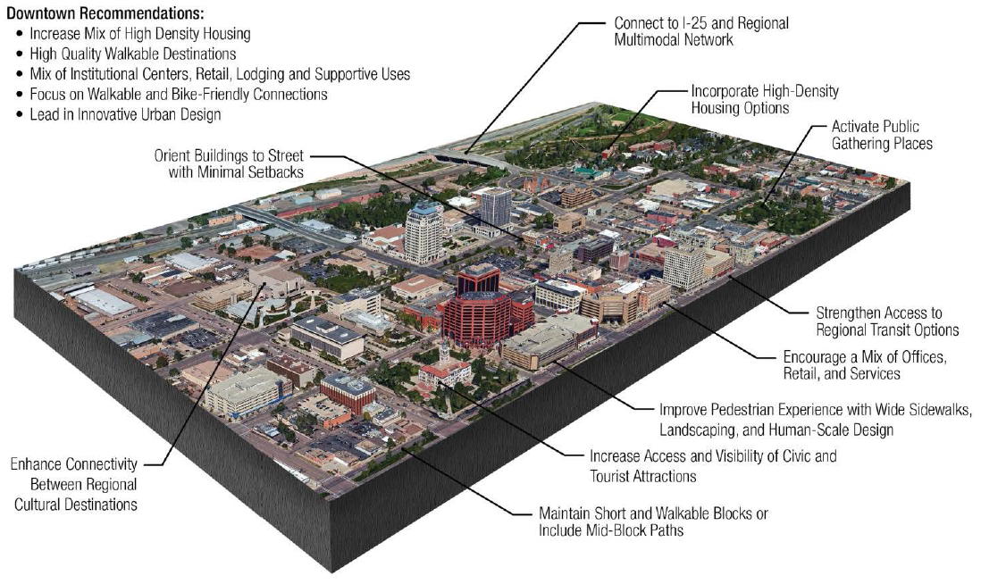
typologies
Typology 6: Downtown
Revised as of 9.24.18

Slide 10
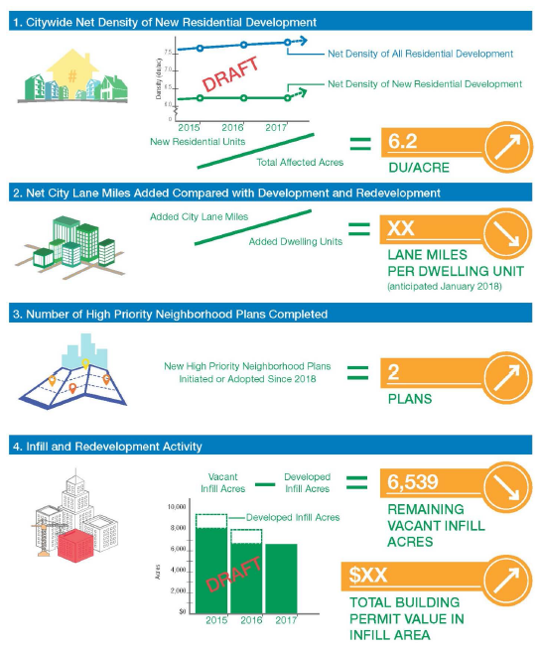
Indicator
Dashboard
Revised as of 9.24.18

Slide 11
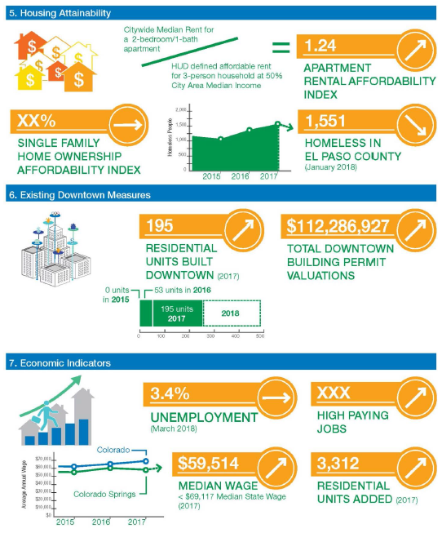
Indicator
Dashboard
Revised as of 9.24.18

Slide 12
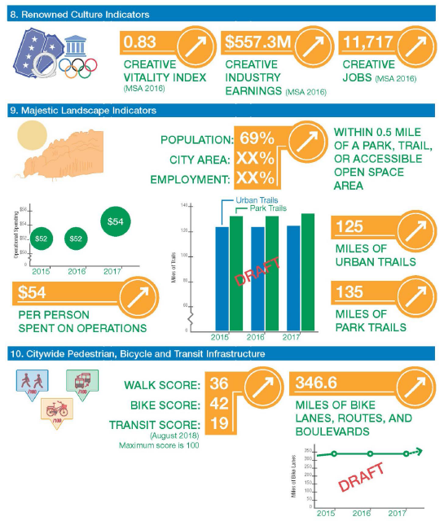
Indicator
Dashboard
Revised as of 9.24.18

Slide 13
URA-applicable strategies etc.

Slide 14
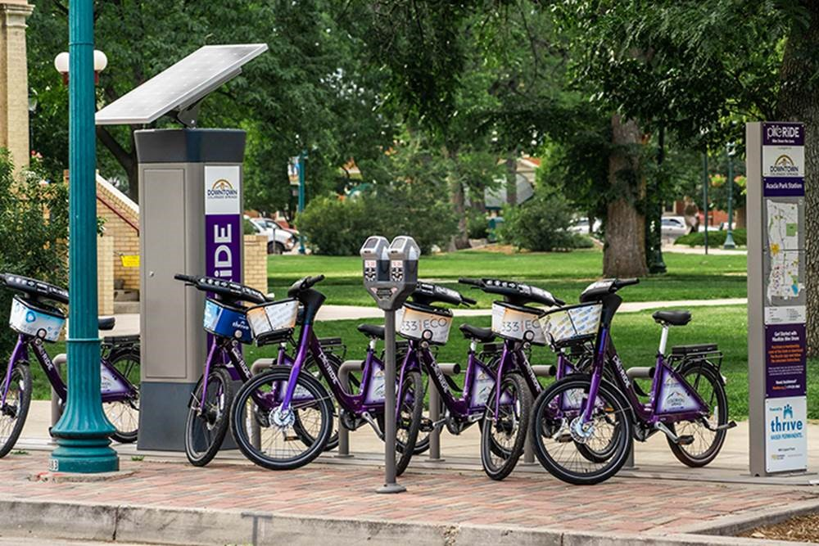
Other Key relevant Topics & Issues
Multimodal options
Infill and redevelopment
Housing attainability and diversity
Stretch goal for transit
Bikeability and walkability
Smart Cities and technology
Thriving Economy incentives
Pike Ride
Notes:
(unable to predict the demand and technology)

Slide 15
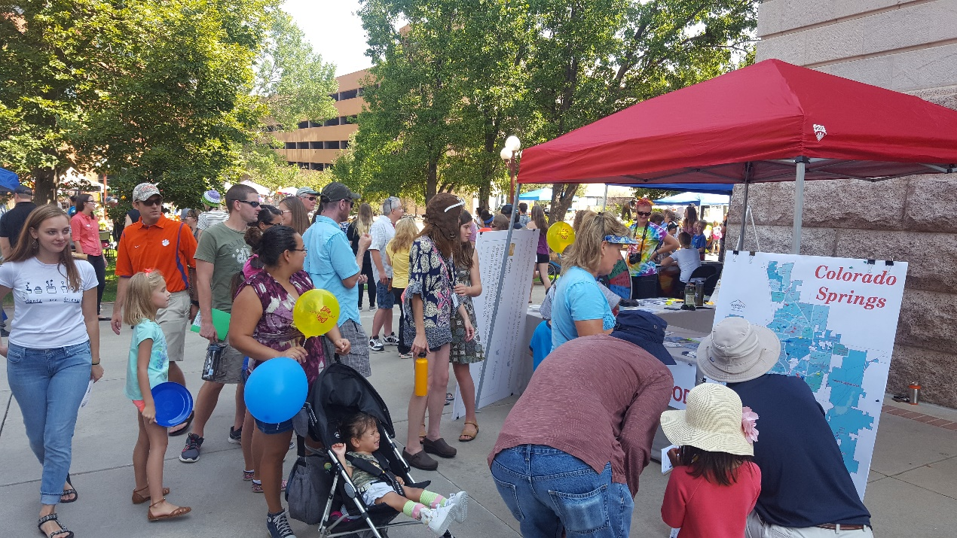
URA-applicable strategies etc.
  Attainable Housing Plan
  References Urban Renewal Plans
    In Unique Places and in list of plans
2017 What if…Festival (September 8, 2017)

Slide 16
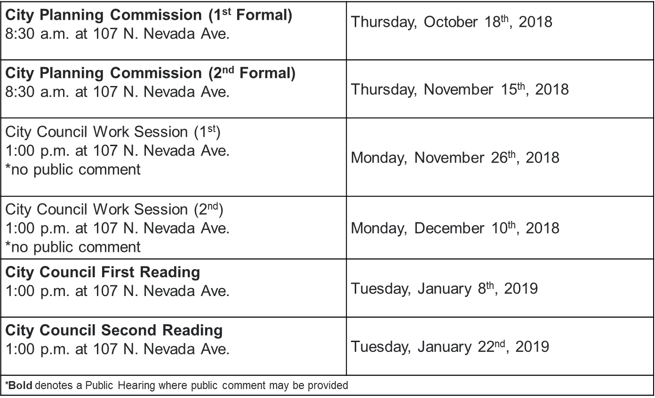
Next Steps

Slide 17
Questions and observations?
Link to Materials
  Peter Wysocki
  pwysocki@springsgov.com
  (719)385-5347
  Carl Schueler
  cschueler@springsgov.com
  (719)385-5391

