Slide 1

Visitor Center Exhibits Concept
Mr. Carlos Cruz-Gonzalez
HQ USAFA/A4
15 Dec 2022

Slide 2
Hosmer Visitor Center

Slide 3
Background
April 2022 - design-scope validation charrette initiated
  NASCO subcontracted to Gallagher
    Gallagher provided recommendations and industry reports
Aug 2022 – CM, A4 and AD leadership met to discuss retail location options and come to consensus on square footage
  Each option under consideration presents USAFA and its design partners with challenges and opportunities
  Given floorplan constraints and balance with Visitor Experience, AD agrees retail mission can be accomplished in 3000 square feet and Fanatics will provide build-outs
  Approved by Gen Clark
Oct 22 – final charrette report delivered
Nov 22 – AFAF “Advisory Committee” zoom call with Gen Gould, Gen Fogleman, Jerry Bruni, Mark Hille, Kelly Banet

Slide 4
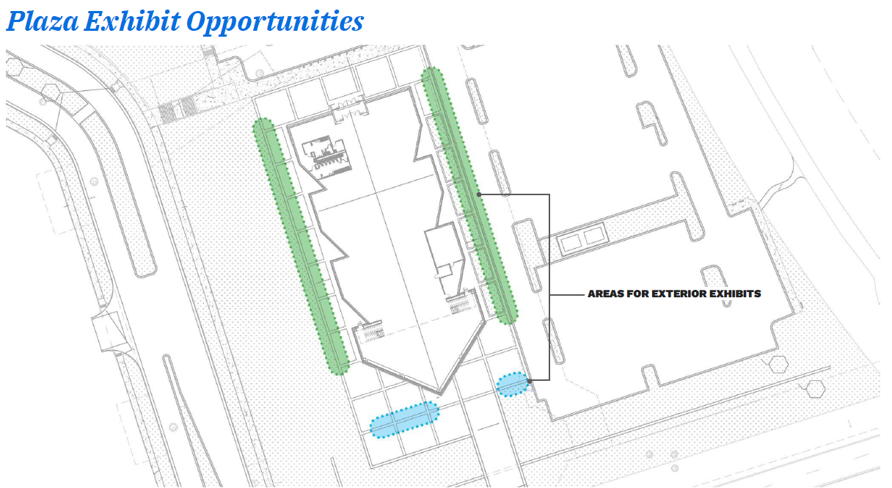
Exterior Plaza and Orientation
Exterior Plaza & Orientation $350,000
a. General Exhibit Fabrication $100,000
b. Graphics $250,000
Notes:
G&A provided an exhibit cost estimate prior to final charrette report. It does not align exactly with their final report which has Academics separated from Recruitment/Training although cost breakdown has them together…

Slide 5
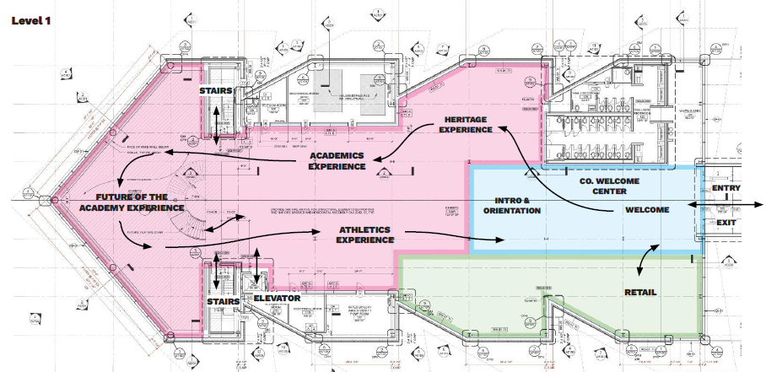
First Floor
Notes:
Minor adjustments in exhibit/experience flow may take place in CLIN2 as G&A designs the exhibits.

Slide 6
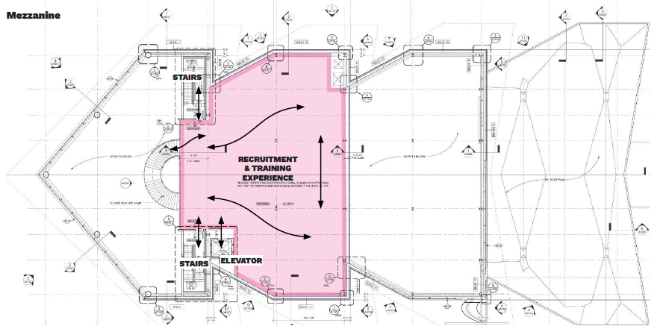
Mezzanine
Notes:
Diagram from charrette report reflects G&A suggestion of mezzanine experience.

Slide 7
Miscellaneous
Subtotal of Interpretive Areas $10,525,000
Exhibit Lighting, Track, Fixtures, Dimming & Controls $1,475,000
Final Digital Art Allowance $450,000
Network & Shared Audiovisual Equipment Systems Allowance $230,000
Audiovisual System Integration Labor Allowance $700,000
Audiovisual Hardware Spares Allowance $150,000
Samples, Mock-Ups, & Prototypes $100,000
Photo, Illustration, & Audiovisual Asset Acquisition Allowance $200,000
Project Engineering & Shop Drawings $150,000
Project Management & Coordination $500,000
Subtotal $3,955,000
Grand Total $14,480,000

