Slide 1
Nevada Ave/Tejon St Corridors
June 22, 2022
Todd Frisbie, PE, PTOE,
City Traffic Engineer

Slide 2
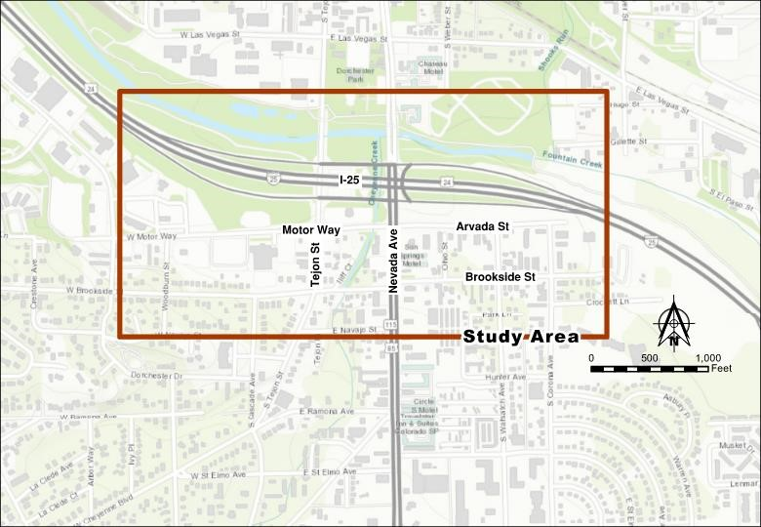
Tejon/Nevada I-25 Interchange Improvements

Slide 3
Tejon/Nevada I-25 Interchange Improvements
PPRTA funded
Study / Design
Construction
Goals of the Study
Identify changes to improve safety for all modes of travel
Improve traffic flow along S. Nevada
Encourage southbound I-25 to access Nevada Avenue at the ramp
Reduce Tejon Street cut-through traffic
Notes:
Provides mobility options for short trips
Reduces vehicle trips by cars and ride share services
Reduces congestion
Complements transit service

Slide 4
Tejon/Nevada I-25
Crash History

Slide 5
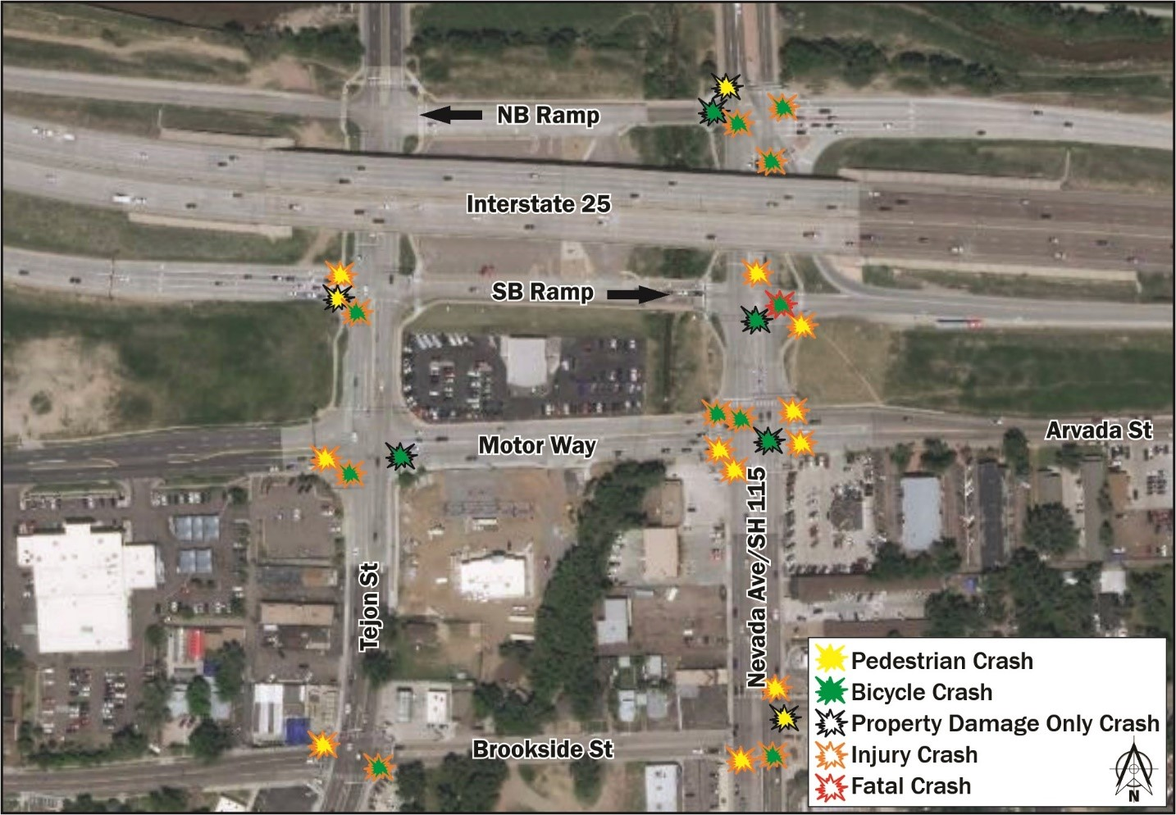
Tejon/Nevada I-25
Crash Issues

Slide 6
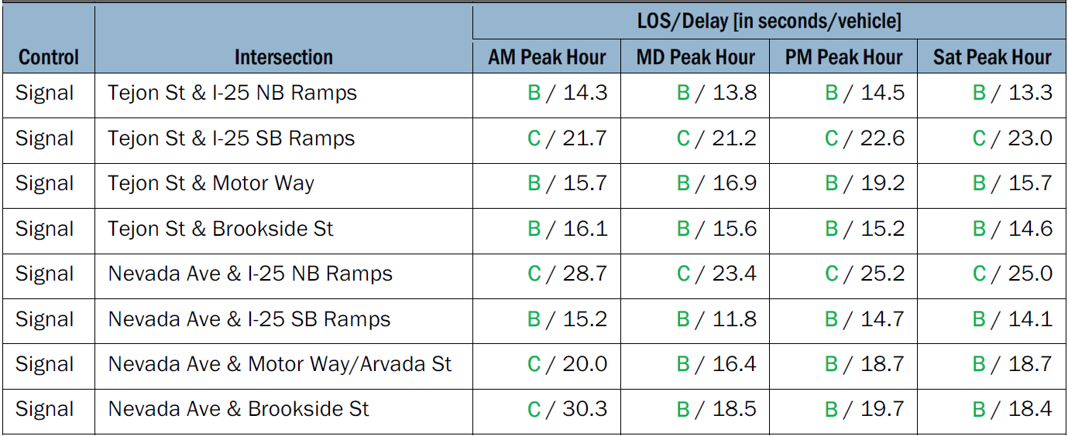
Tejon/Nevada I-25
Intersection Operations

Slide 7
Tejon/Nevada I-25
Intersection Operational Issues
The current design has poor operations for vehicles wanting to go from southbound I-25 to southbound Nevada
There is only a single through lane on the southbound ramp at Tejon (LOS D)
There is only a shared right-turn lane on southbound ramp at Nevada (LOS E)
Tejon/Brookside and Nevada/Brookside have poor side street operations
Queues often extend through adjacent intersections on Nevada and Tejon

Slide 8
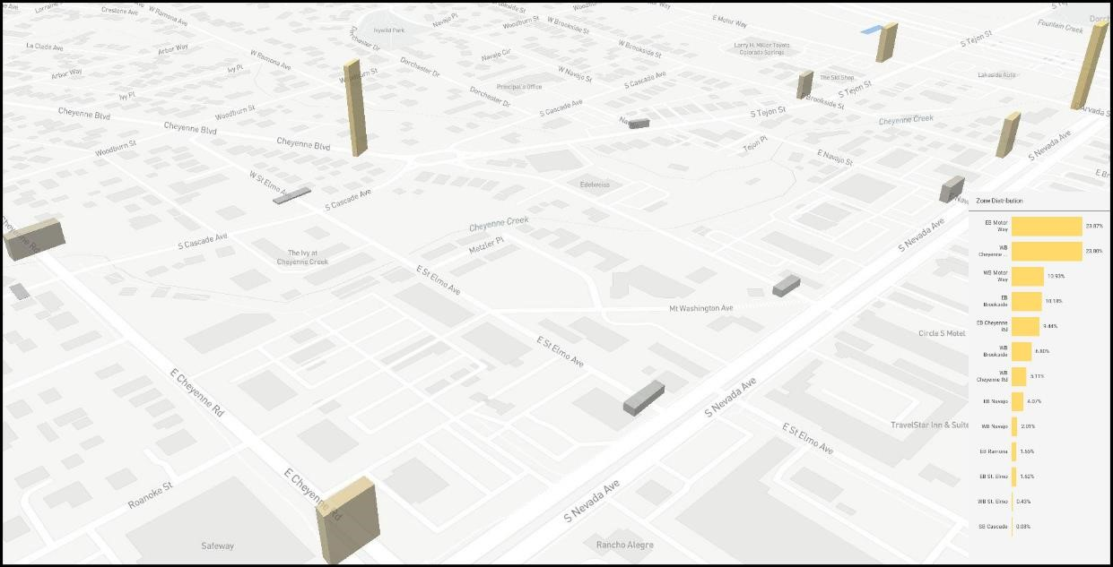
Travel Patterns – SB I-25
47-55% of Southbound I-25 traffic turning on Tejon is going to Nevada
Vehicles use side streets to get to Nevada:
Motor Way – 23.9%
Brookside Street – 10.1%
Navajo Street – 6.0%
Ramona Avenue – 1.6%
St Elmo Avenue – 1.6%
Cheyenne Road – 9.4%

Slide 9
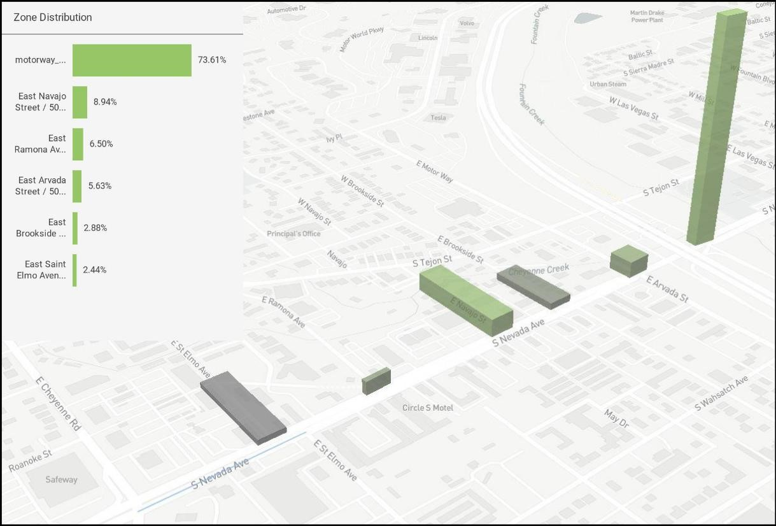
Travel Patterns – NB I-25
25% of Northbound I-25 traffic from Nevada uses Tejon as a cut-through
Vehicles use side streets to get to I-25:
Motor Way – 6.5%
Brookside Street – 2.9%
Navajo Street – 8.9%
Ramona Avenue – 6.5%
St Elmo Avenue – 2.4%

Slide 10
Proposed Improvements
Eastbound Ramp
Single eastbound right on to Tejon
Two eastbound through lanes with dual right turn lanes at Nevada
Tejon
Nevada
Notes:
Provides mobility options for short trips
Reduces vehicle trips by cars and ride share services
Reduces congestion
Complements transit service

Slide 11
Proposed Improvements
Eastbound Ramp Intersections
Tejon
Nevada
Notes:
Provides mobility options for short trips
Reduces vehicle trips by cars and ride share services
Reduces congestion
Complements transit service

Slide 12
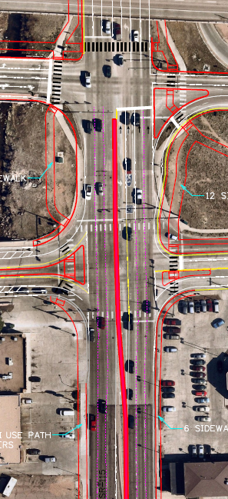
Proposed Improvements
Nevada Avenue
Northbound Nevada reconfigured to allow both left and middle lanes to access northbound I-25
Install median between the ramps and Brookside
N
Notes:
Provides mobility options for short trips
Reduces vehicle trips by cars and ride share services
Reduces congestion
Complements transit service

Slide 13
Proposed Improvements
Motor Way
Two-lanes with bike lanes
Right-in/right-out at Nevada, remove signal
Tejon
Nevada
Notes:
Provides mobility options for short trips
Reduces vehicle trips by cars and ride share services
Reduces congestion
Complements transit service

Slide 14
Proposed Improvements
Motor Way Intersections
Tejon
Nevada
Notes:
Provides mobility options for short trips
Reduces vehicle trips by cars and ride share services
Reduces congestion
Complements transit service

Slide 15
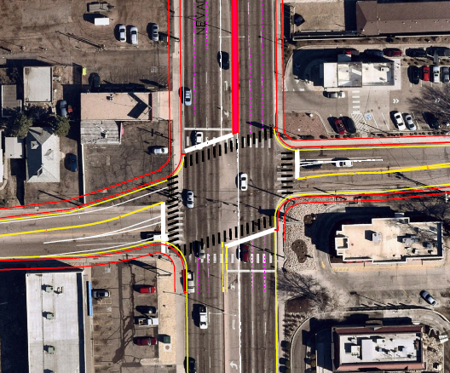
Proposed Improvements
Brookside Avenue
Fix intersection offset at Nevada
Notes:
Provides mobility options for short trips
Reduces vehicle trips by cars and ride share services
Reduces congestion
Complements transit service

Slide 16
Proposed Improvements
Pedestrian/Bike
Wider sidewalks
Install additional sidewalks
Narrow pedestrian crossings at Nevada/Motor City
Bike lanes on Motor City
Green painted bike crossings on Tejon
Protected bike lanes at Tejon/Motor City
Notes:
Provides mobility options for short trips
Reduces vehicle trips by cars and ride share services
Reduces congestion
Complements transit service

Slide 17
CDOT Planned Improvements
Roadway
Pavement Overlap south from Brookside
Upgrades to sidewalks and pedestrian ramps at intersections
Rebuilt Traffic Signals
St. Elmo
Ramona
At Chick-Fil-A access
Notes:
Provides mobility options for short trips
Reduces vehicle trips by cars and ride share services
Reduces congestion
Complements transit service

Slide 18
Traffic Redistribution

Slide 19
QUESTIONS?

