Slide 1
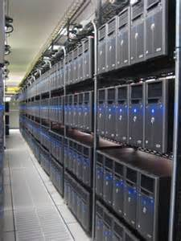
PRESENTATIONFOR
Colorado Springs Urban Renewal Authority
regarding status of development progress
T5@Colorado Data Center Campus
March 23, 2016
Top Tier. Bottom Line. www.t5datacenters.com

Slide 2
DEVELOPMENTTEAM
IRONPOINT PARTNERS
Washington, DC.
VINEYARD, LLC
Colorado Springs
IP/VINEYARD
Colorado Springs
T5 DATA CENTERS
Atlanta
VINEYARD/T5
Colorado Springs
Top Tier. Bottom Line. www.t5datacenters.com

Slide 3
DEVELOPMENTTEAM
IRONPOINT PARTNERS
Washington, DC.
IRONPOINT PARTNERS
Washington, DC.
Based in Washington, DC
Private equity real estate fund formed in 2007
Prior, the team managed real estate investment for Robert M. Bass
Currently focused on investments primarily in data centers and senior living
One of the most experienced investors in data center developments in the country
Iron Point currently manages in excess of $2 billion in equity across several funds
Top Tier. Bottom Line. www.t5datacenters.com

Slide 4
DEVELOPMENT
TEAM
Founded in 2008 to form a development company focused on the interests of clients with data center needs.
Based in Atlanta, GA
T5 advising & building data centers since 1995
Exclusively a data center owner, operator and developer since 2008
Principal involvement and leadership
100+ mission critical projects - 11M square feet
T5 DATA CENTERS
Atlanta
T5 DATA CENTERS
Atlanta
Top Tier. Bottom Line. www.t5datacenters.com

Slide 5
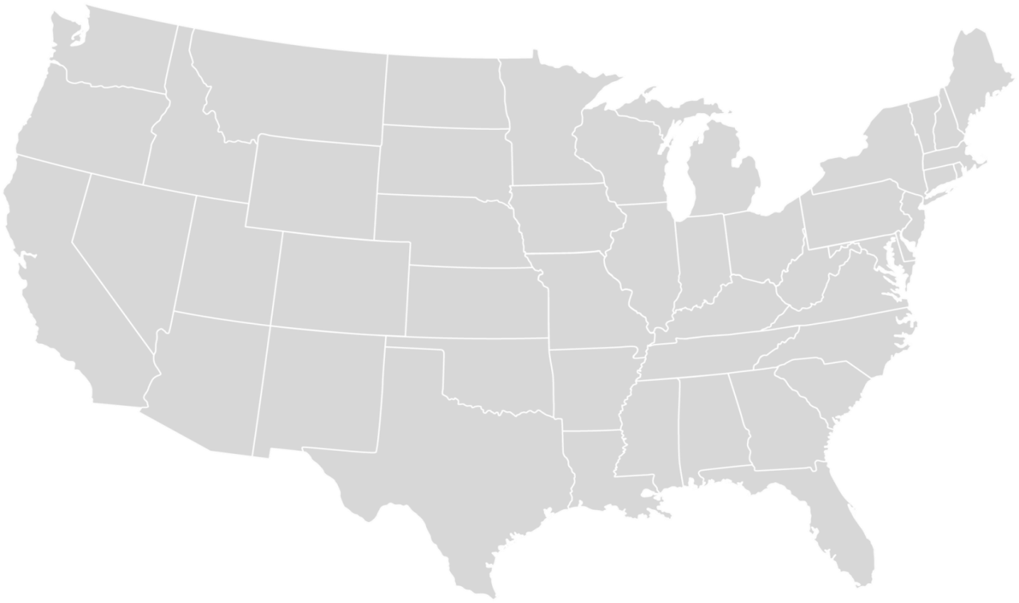
NATIONALPLATFORM
T5@Portland
T5@NY
T5@Colorado
T5@LA
T5@Kings Mountain
T5@Atlanta
T5@Dallas
Top Tier. Bottom Line. www.t5datacenters.com

Slide 6
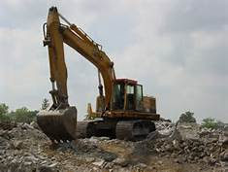
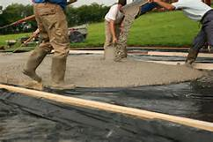
TIF PLAN
Codified in 2012
Reimburses up to $54M in approved expenditures
Development of public infrastructure:
road construction
enhanced power delivery
water/sewer delivery
drainage improvements
open space development for public use
Currently, Developer has incurred approximately $4M in expenses
Preparing to submit to District Cost Engineer for certification
Top Tier. Bottom Line. www.t5datacenters.com

Slide 7
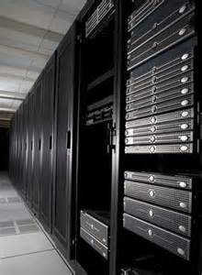
VINEYARDMETRODISTRICT
Founded in 2012.
MD Counsel:
McGeady Becher, Denver
MD Accountant:
Stockman Kast Ryan
MD Board Members:
Vincent Colarelli
Janet Colarelli
Top Tier. Bottom Line. www.t5datacenters.com

Slide 8
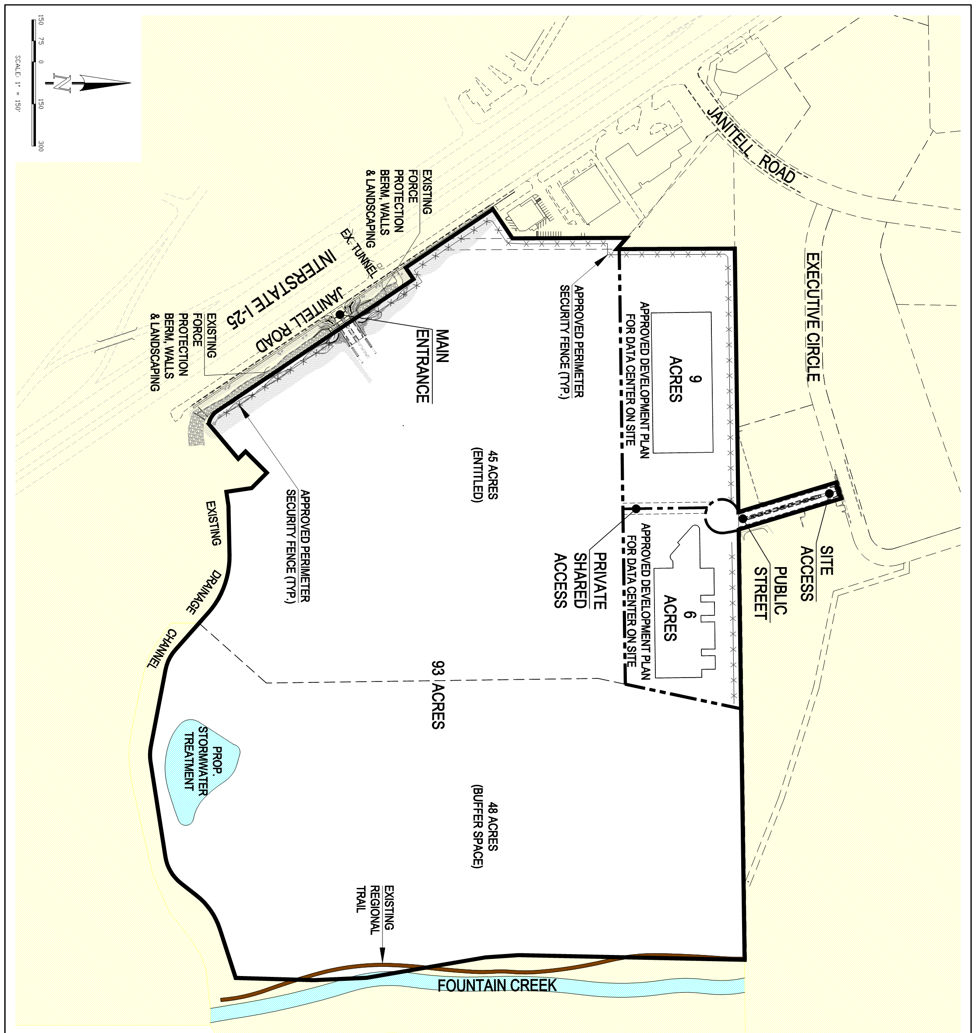
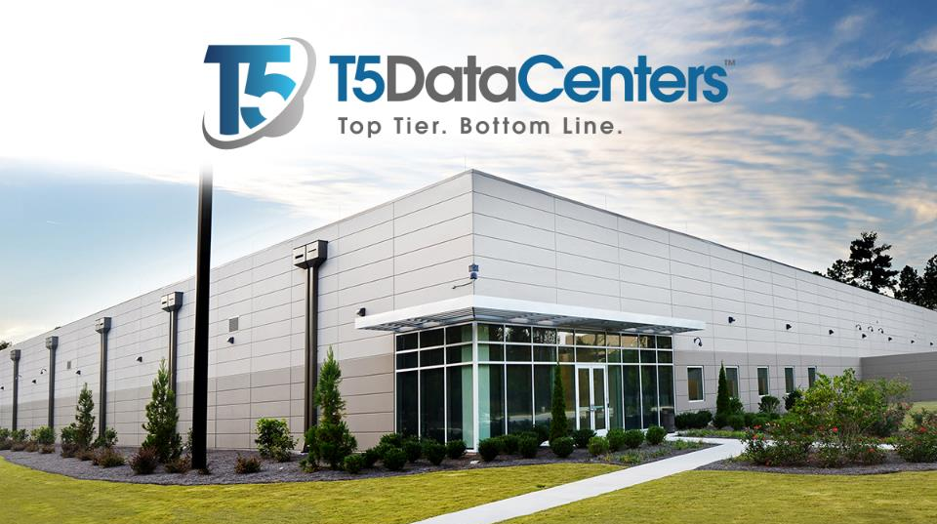
DEVELOPMENTPROGRESS
Development Plan approved on two sites
Top Tier. Bottom Line. www.t5datacenters.com

Slide 9
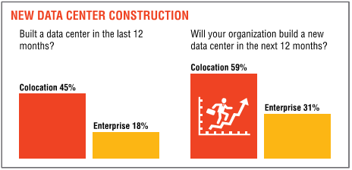
MARKETCONDITIONS
Uptime Institute Industry Survey 2015 Results:
Top Tier. Bottom Line. www.t5datacenters.com

Slide 10
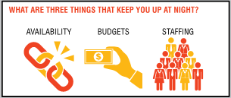
MARKETCONDITIONS
Uptime Institute Industry Survey 2015 Results:
Top Tier. Bottom Line. www.t5datacenters.com

Slide 11
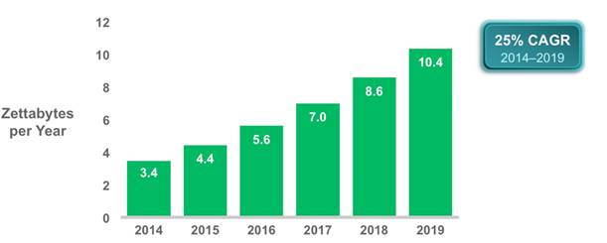
MARKETCONDITIONS
Global Data Center IP Traffic: Three-Fold Increase by 2019
Figure summarizes the forecast for data center IP traffic growth from 2014 to 2019
Source: Cisco Global Cloud Index, Cisco Systems
Top Tier. Bottom Line. www.t5datacenters.com

Slide 12
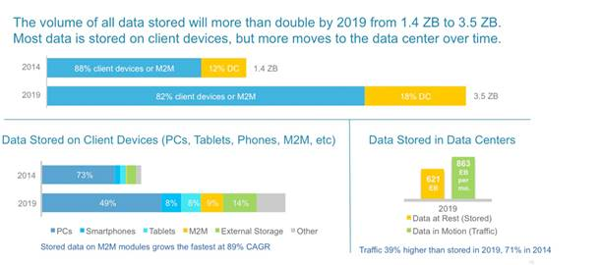
MARKETCONDITIONS
Growth of Data Storage: More Than Two-Fold Increase by 2019
Figure summarizes the forecast for data storage growth from 2014 to 2019
Source: Cisco Global Cloud Index, Cisco Systems
Top Tier. Bottom Line. www.t5datacenters.com

Slide 13
Colorado Springs Market Analysis - Wholesale 21 Nov 2014
Kelly Morgan, Research Director, Multi-Tenant Datacenters

Slide 14
Colorado Springs Wholesale Opportunity
In the Colorado Springs area, we consider the addressable local market for wholesale datacenter space to be Colorado Springs and Denver. This area has a combined population of over 3.3m, GDP of nearly $200Bn and the headquarters of 9 Fortune 500 companies plus 10 Fortune 1000 companies. It is home to many IT firms, both well-known and start-ups.
The area is a prime datacenter location for enterprises headquartered outside Colorado, either to serve their operations from a central US location, or as a backup/disaster recovery site. Examples of outside firms that have built datacenters in Colorado Springs include: Agilent Tech, Federal Express, Hewlett Packard, LSI, Progressive Insurance, USAA, Verizon Wireless, Walmart.
Colorado Springs is a more appealing location for wholesale datacenter space (and for enterprise datacenters in general) than Denver due to its power being nearly half the price.
The area currently is not served by any specialized wholesale datacenter providers other than H5 in Denver, which took over an old facility formerly targeting the airline industry, and Stream Data Centers in Denver, which has a small facility (<10,000 op. sq. ft) for lease.

Slide 15
Colorado Springs Wholesale Competition - Local
For businesses local to Colorado Springs (e.g. local government, universities, healthcare firms), a wholesale provider would have NO similar competition. Competition would come from potential customers choosing to build datacenters themselves.
In-house builds require large amounts of capital and are typically more expensive to build/run than datacenters built/run by experienced specialists. It is also difficult to determine the right size to build.
Thus, where enterprises have a wholesale option, they often prefer to lease space rather than build their own.
For businesses in and around Denver, a wholesale provider in Colorado Springs would in theory compete with datacenter providers in Denver, however:
Electricity prices in Colorado Springs are lower than in Denver ($0.045 compared to $0.08 or $0.09) and there is plenty of network fiber available.
Most enterprises say they want datacenters within 1-1.5 hours’ drive for their IT staff. Colorado Springs is roughly 70 miles south of Denver and many of Denver’s IT firms and large enterprises are headquartered in the south of the city, so the facility would be within that range.

Slide 16
Absorption (Supply/Demand) Estimates
Estimated supply/demand in Portland
(following introduction of wholesale in 2012)
Source: 451 Research estimates
We believe the supply/demand dynamics for wholesale space in Colorado Springs would look similar to those of Portland, where there was no wholesale space until 2012. Once available, at least 20,000 sq. ft. of wholesale has been leased each year, with much more leased in 2014 thanks to a large enterprise deal.

Slide 19
MARKETPROSPECTS
PROSPECTS SINCE 1/1/15
International Technology Services Institution
International Financial Institution
National Financial Institution
National Financial Institution
National Financial Institution
International Technology Services Institution
Regional Technology Services Institution
National Healthcare Institution
National Healthcare Institution
National Technology Services Institution National Technology Services Institution
National Technology Services Institution
Top Tier. Bottom Line. www.t5datacenters.com

Slide 20
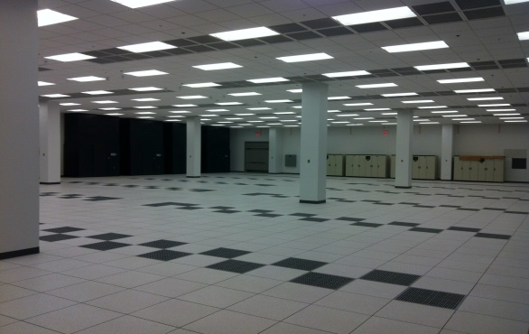
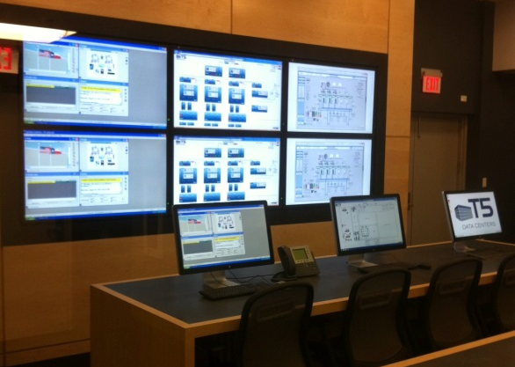
PENDINGDEALS
8.5 Acre Land Sale
$150M Development Cost
$130M in Hardware and Software
10.5 Acre Development Deal
$120M Development Cost
$80M in Hardware and Software
15 Acre Land Sale/Development Deal TBD
$200M Development Cost
$175M in Hardware and Software
the values stated above are estimates only and are approximate only
Top Tier. Bottom Line. www.t5datacenters.com

Slide 21
MANAGEDSERVICES
Third Party Provider of Retail Data Center Space and Facilities – Partnered Relationship with Local Firm
Highly Experienced Certified Staff
Use of Best Practices are Standard
Often Cloud Based Access for Users
Support Anytime and Anywhere
Reliability Obligations Based on SLA
24/7 Monitoring by Engineering Staff
Top Tier. Bottom Line. www.t5datacenters.com

Slide 22
WHATTOEXPECT
In the coming months, the following development obligations will be in progress:
Announcement of transactions
Grading for initial development site
Extension of enhanced power from multiple substations
Approval of third Development Plan
Extension of roadways and campus infrastructure
Ground breaking for construction of first data center
Submission of initial cost certification package
Top Tier. Bottom Line. www.t5datacenters.com

