Slide 1
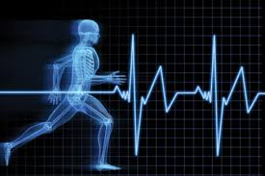
William J. Hybl Sports Medicine and Performance Center
UUni

Slide 2
Commencement of Substantial Work
UCCS has taken a series of significant actions demonstrating a commitment to complete the construction of the William J. Hybl Sports Medicine and Performance Center facility and to provide programs in the facility designed to accomplish the goals for the project as described in the resolution of the Economic Development Commission.

Slide 3
Goals for the William J. Hybl Sports Medicine and Performance Center
The William J. Hybl Sports Medicine and Performance Center will:
Be a nationally known destination for elite athlete medical and performance-based clinical, testing and counseling services;
Be a site for innovative sports medicine and sports performance research and related educational opportunities; and
Strive to elevate the goals and ideals of elite athlete organizations.

Slide 4
Requirements of the Hybl Center
The William J. Hybl Sports Medicine and Performance Center must:
Be housed in a minimum 72,000 gsf facility located on the UCCS Campus in the Health and Wellness Village;
Provide state of the art clinical and other space to provide an array of services to support elite athletes including human performance testing, biomechanics, medically-based fitness, physical therapy, and an orthopedic anchor;
Provide space for academic instruction, continuing education, innovative research, and faculty offices;
Include three centers of excellence in disciplines related to sport performance and rehabilitation as determined by UCCS; and
Have adjacent parking.
Notes:
Notice the parking slide later on!

Slide 5
Prerequisites
UCCS must obtain letters from at least 10 NGB’s or other organizations providing support for elite athletes or disabled veterans certifying that UCCS or its faculty have professional relationships with them.
Completed.
Letters presented to the EDC on February 12, 2015. No concerns expressed and requirement considered satisfied. (See Minutes of February 12, 2015 Commission meeting)
UCCS must enter into an written agreement with CSURA.
Completed.
Agreement executed June 26, 2015.
UCCS must certify to the EDC, through a UCCS executive and the Project architect, that all of the design elements have been included in the Project element design plans.
UCCS must commence substantial work by December 16, 2018.

Slide 6
Significant Actions Taken to Date
Various dates in 2016 – Site visits by key personnel to renowned sports medicine and performance centers:
The Orthopedic Specialty Hospital, Salt Lake City, UT
United States Ski and Snowboard Association, Park City, UT
Promedica, Toledo, OH
The Andrews Institute, Gulf Breeze, FL
The Mayo Clinic, Rochester and Minneapolis, MN
The Sanford Clinic, Sioux Falls, SD
February 17, 2017 – Board of Regents approves naming the sports medicine and performance center for William J. Hybl. The center will be known as the “William J. Hybl Sports Medicine and Performance Center.” (Hybl Center).
February, 2017 – UCCS enters into a Letter of Agreement with Centura Health to collaborate in the development of the Hybl Center.
March, 2017 – UCCS and Centura Health complete a functional program plan for the Hybl Center in preparation for work on the building program plan.

Slide 7
Functional Program Plan Goals
Develop an innovative, integrated and sustainable sports medicine program for elite and amateur athletes, and all individuals who desire to achieve and to maintain active, healthy lifestyles;
Develop sports medicine and human performance research and education programs to promote optimal performance and sustainable standards of higher health; and
Provide human performance testing, training and educational services that empower elite amateur, professional and semi-professional athletes, first responders, military personnel, wounded warriors, youth sport participants, club sport participants, recreational and masters athletes, workplace athletes and all other individuals in achieving their unique, personal performance goals.

Slide 8
Functional Program Plan Clinical Areas of Focus
Orthopedic sports medicine
Primary care sports medicine
Physical medicine, therapy and rehabilitation
Occupational therapy
Athletic training
Pain management
Imaging
Body composition and bone health
Performance training
Occupational and tactical scenario training
Altitude/environmental training facility

Slide 9
Functional Program Plan Academic Areas of Focus
Applied Physiology/Exercise Science
Exercise physiology/human performance
Biomechanics and motor learning
Strength and Conditioning
Athletic Training (MSAT)
Sports nutrition
Sports performance
Coaching development
Human anatomy & physiology
Performance at environmental extremes
Body composition and bone health
Clinical outcomes

Slide 10
Proposed Centers of Distinction
The Center for Athletes and Active Individuals with Physical Disabilities
The Environmental Health and Performance Center
The Center for Tactical and Occupational Athlete Performance

Slide 11
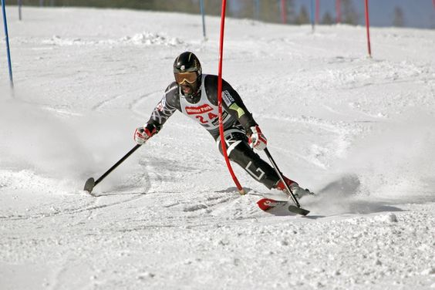
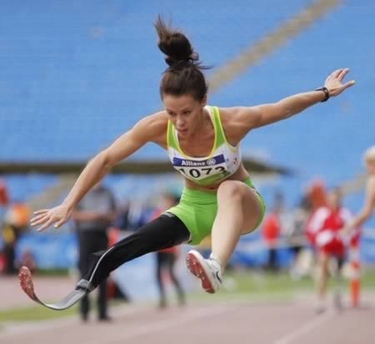
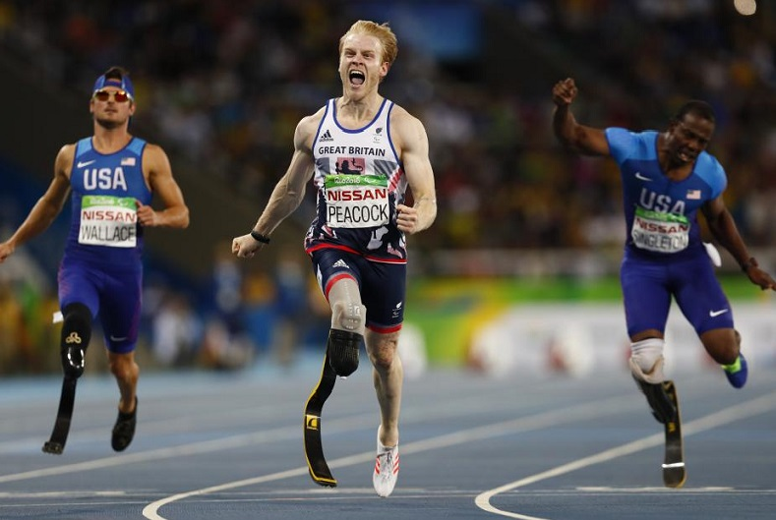
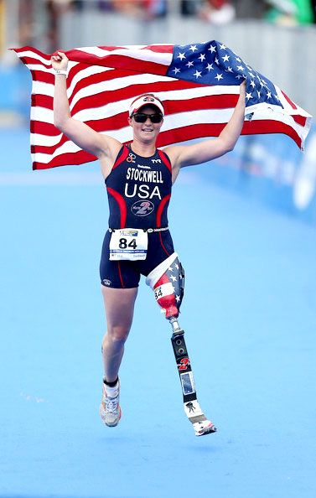
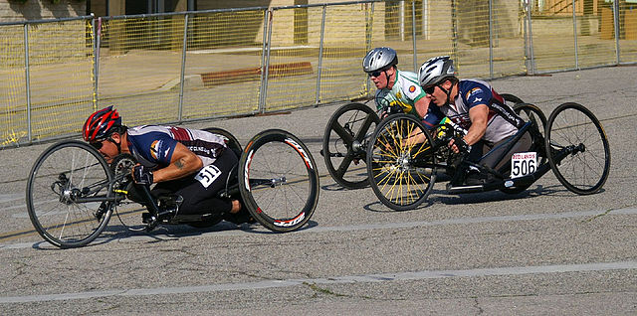
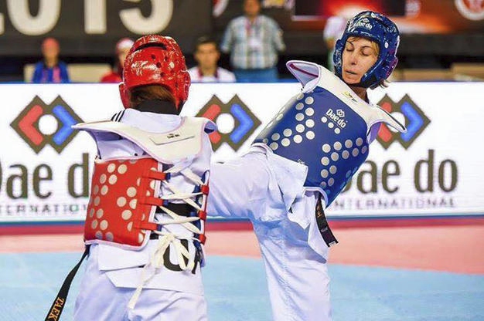
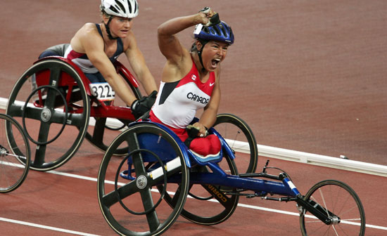
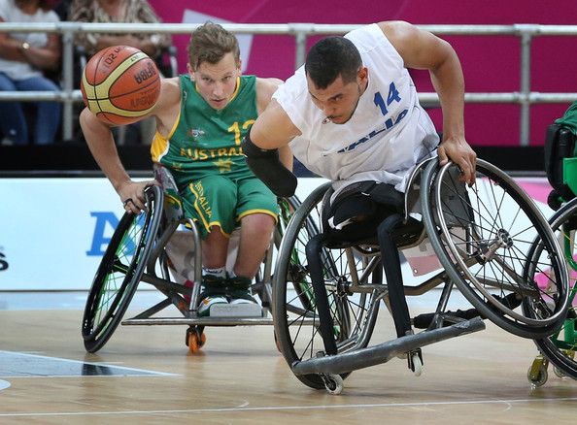
The Center for Athletes and Active Individuals with Physical Disabilities
Notes:
Para-athletes are capable of remarkable feats of performance

Slide 12
The Center for Athletes and Active Individuals with Physical Disabilities
Athletes & Active Individuals with Physical Disabilities
Human Resilience
Performance Training
Biomechanics & Engineering
Environmental Physiology
Medical Clinics
Sports Nutrition

Slide 13
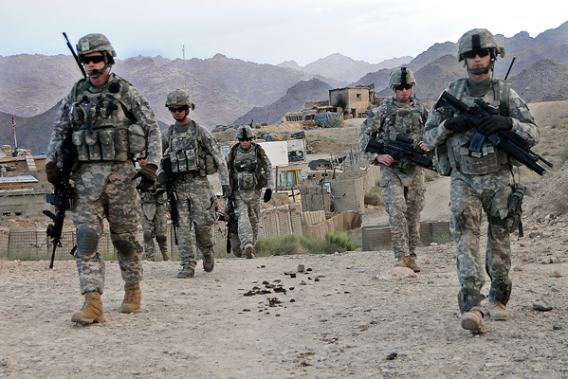
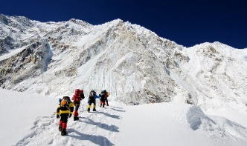
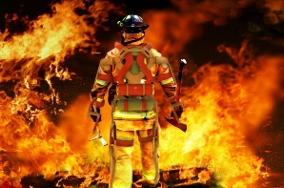
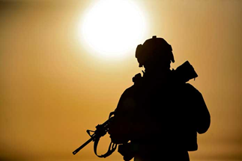
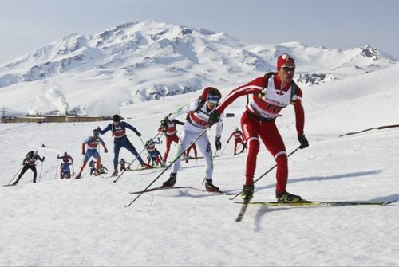
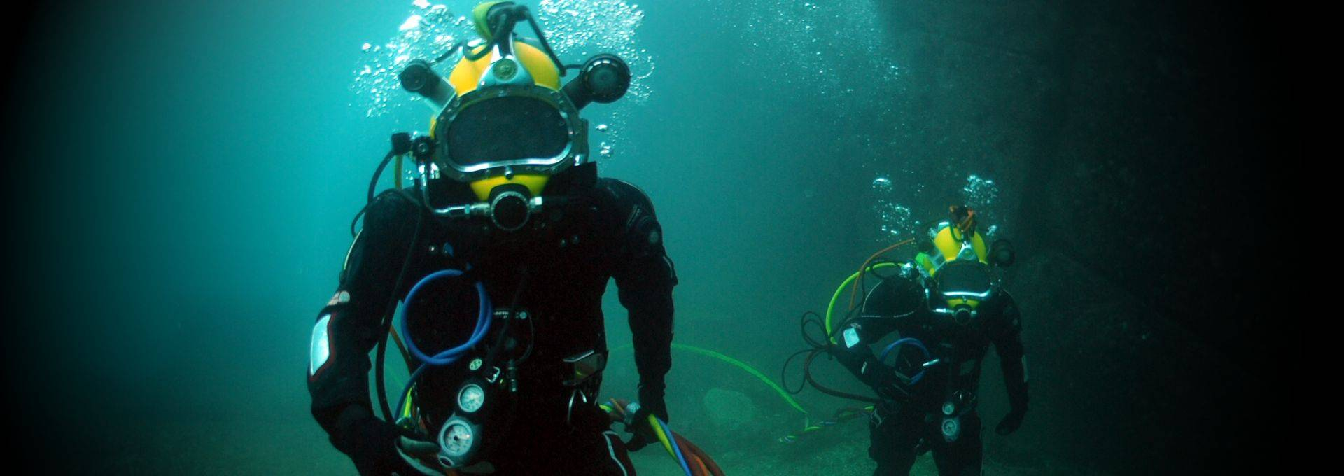
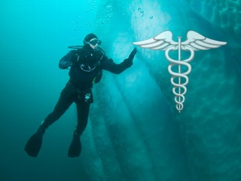
The Environmental Health and Performance Center
Altitude
Extreme Heat
Hyperbaria
Extreme Cold
Notes:
Athletes, military personnel, emergency responders, occupational athletes and active individuals are exposed to environmental extremes

Slide 14
The Environmental Health and Performance Center
Health and Performance in Extreme Environments
Human Resilience
Performance Training
Occupational Research & Performance
Biomechanics & Engineering
Environmental Physiology
Medical Clinics
Sports Nutrition

Slide 15
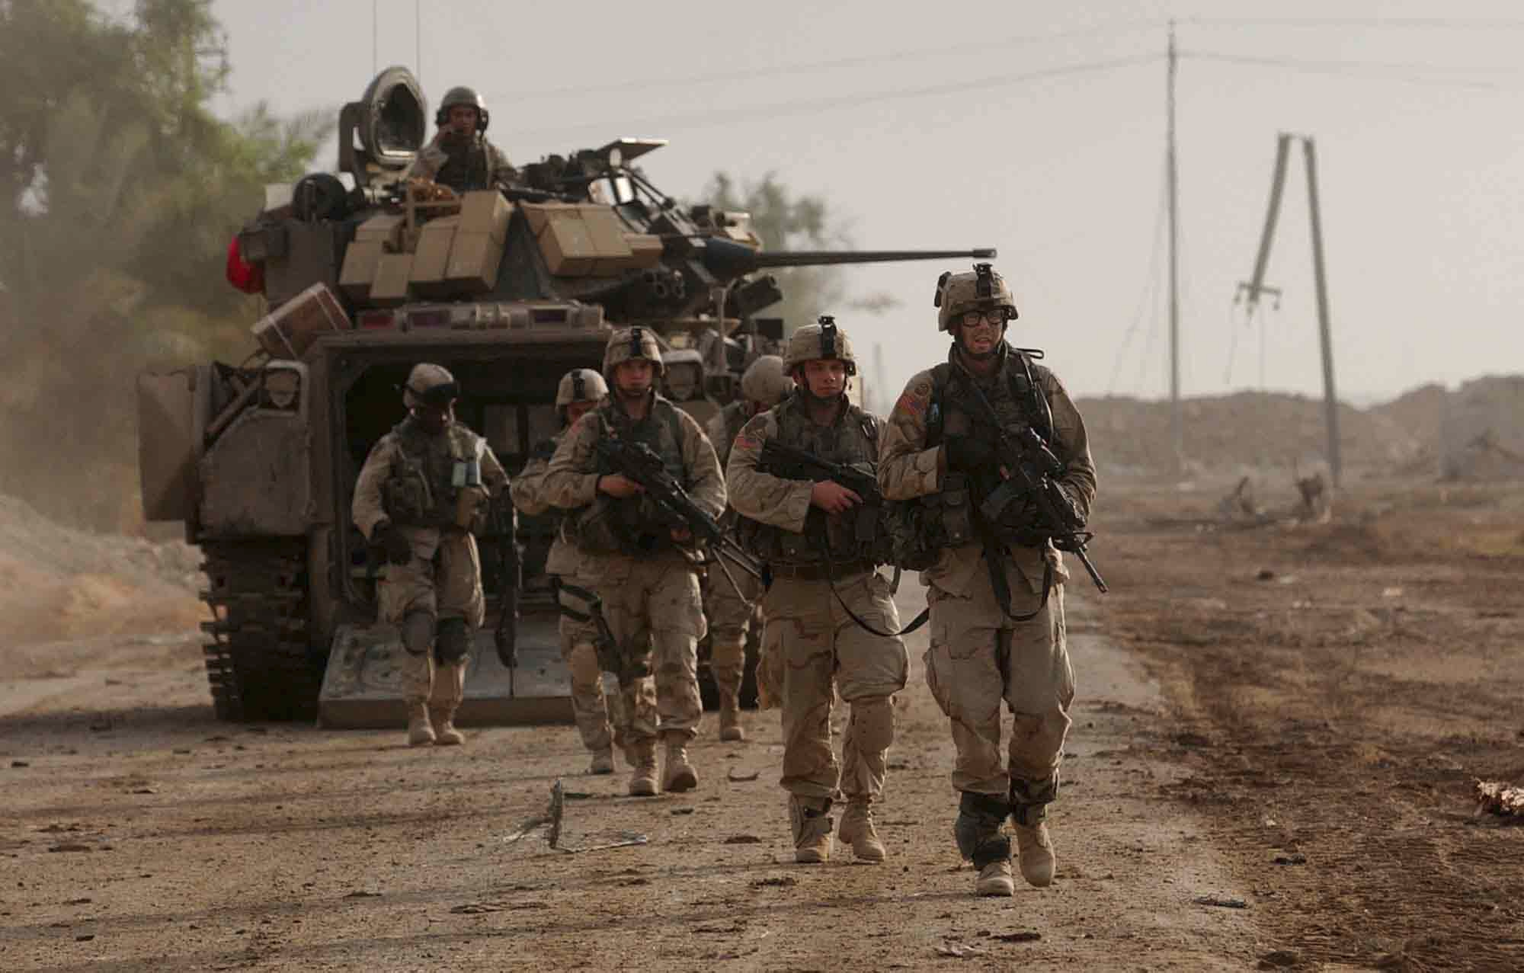
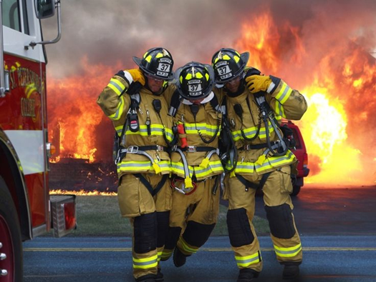
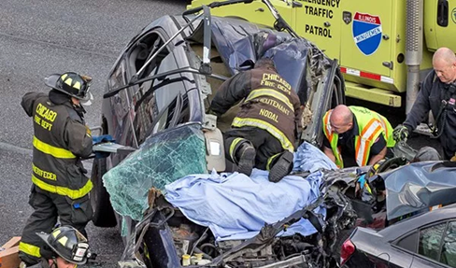
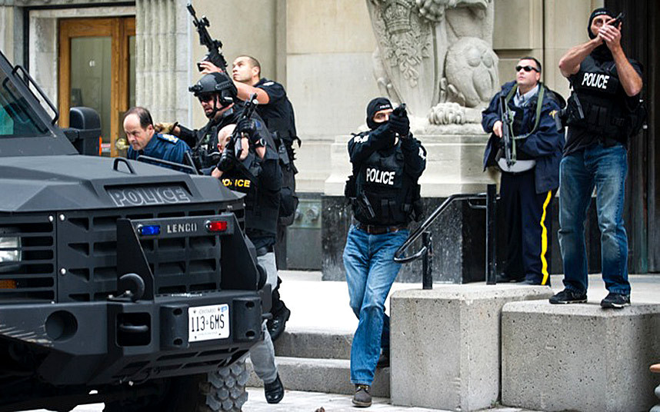
The Center for Tactical and Occupational Athlete Performance
Notes:
University of Wisconsin, Milwaukee (Dept of Kinesiology): Occupational Athletes: An Integrated Approach to Firefighting Performance, May 2013;
Professional athletes make their living off of their physical assets. So do “occupational athletes.” This Center focuses on the similarities between job preparedness and how professional athletes prepare for sport competition.

Slide 16
The Center for Tactical and Occupational Athlete Performance
Military
Tactical
1st Responders
Occupational Athletes
Human Resilience
Performance and Scenario Training
School of Public Affairs
Occupational Research & Performance
Biomechanics & Engineering
Environmental Physiology
Medical Clinics
Sports Nutrition
Notes:
Existing Centura and UCCS resources will be integrated to develop programs for the targeted population

Slide 17
Significant Actions Continued
May of 2017 – Building Program Plan is completed for 104,800 gsf facility with a projected cost of $61,425,000.
May 24, 2017 – Board of Regents Capital Construction Subcommittee recommends that the Board approve the program plan and authorize spending authority at $61.425 million.
June 16, 2017 – Board of Regents approves the subcommittee’s recommendation.

Slide 18
Significant Actions Continued
June 21, 2017 – the Capital Development Committee of the Legislature approves spending authority for the Hybl Center in the amount of $61,425,000.
January, 2018 – Centura Health and UCCS enter into a 20- year lease agreement for Centura Health’s occupation of space in the Hybl Center.
February 12, 2018 – UCCS and JE Dunn Construction Company enter into a Design/Build GMP Agreement. On February 15, UCCS issues a notice to proceed.

Slide 19
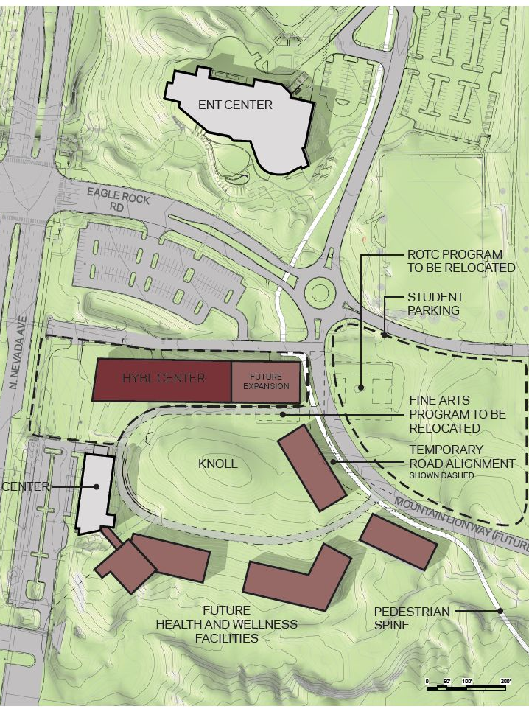
Hybl Center Project
Approximately 104,000 gsf.
Located next of the Lane Center on North Nevada in the UCCS Health and Wellness Village
Project Cost
$61,425,000 Building
$3,530,448 Infrastructure
Bond Issuance
Estimated September 2018

Slide 20
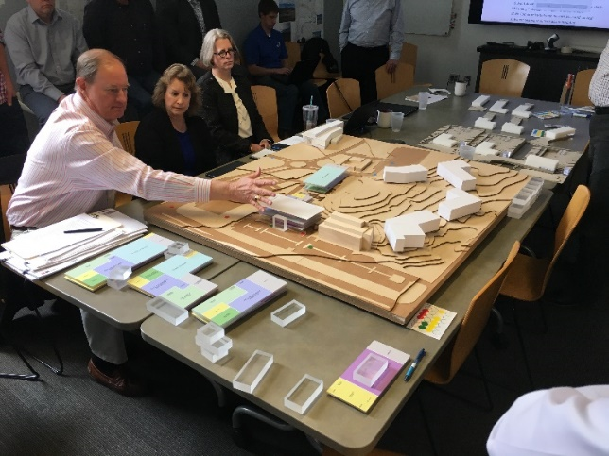
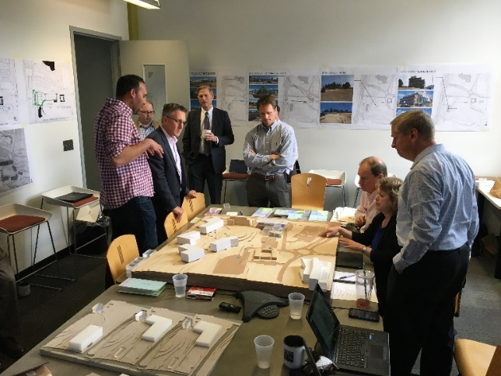
Current Status
Our project team is presenting the HYBL Sports Medicine and Performance Center pre-design package on Thursday, 4/12 to the State Design Review Board (DRB).
We have had or will soon hold several charrettes, including planning, site, and sustainability.
We are working through schematic design, holding our second round of meetings with our various UCCS and Centura user groups this week.
We anticipate going to the DRB in May with our concept design package and to the DRB in July with the schematic design package.

Slide 21
Projected Schedule
July 13, 2018 – Schematic Design to DRB
September 13, 2018 – Design Development to DRB
September, 2018 – Ground Breaking
October, 2018 – Construction Start
January 31, 2020 – Substantial Completion

Slide 22
Certification of Requisite Design Elements
Upon CU Design Review Board’s acceptance of the Schematic Design package (anticipated 7/12/18) and the contractor’s overall project schematic design budget recap, the project architect and a UCCS executive official will be able to certify to the Economic Development Commission that the Hybl Sports Medicine and Performance Center building design plans have all of the requisite design elements.

Slide 23
Examples of Site Work to Date

Slide 24
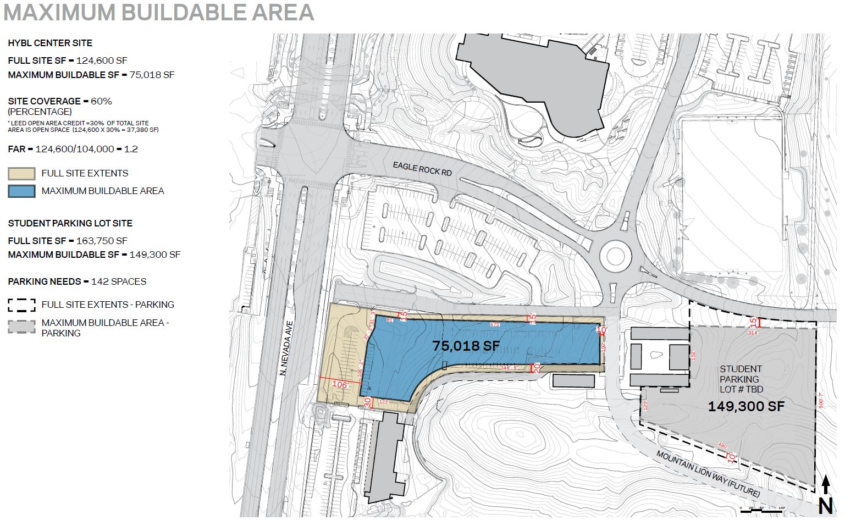

Slide 25
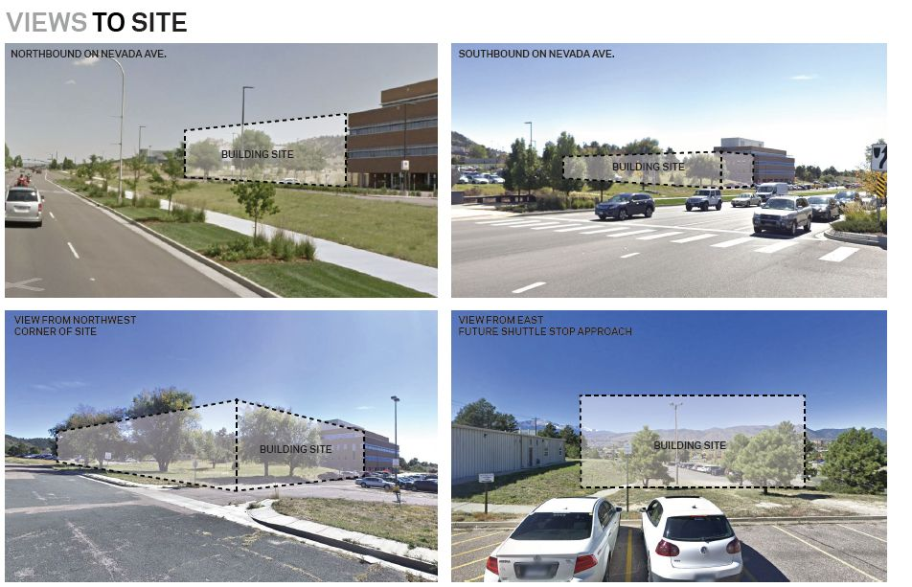

Slide 26
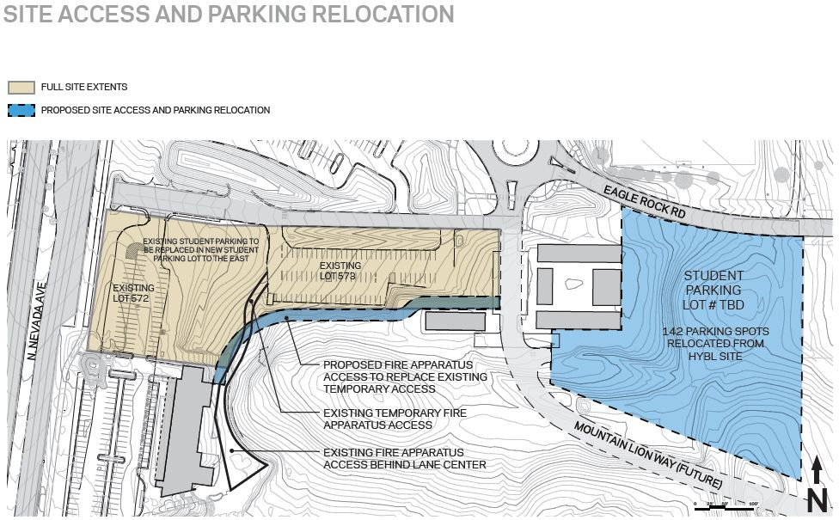

Slide 27
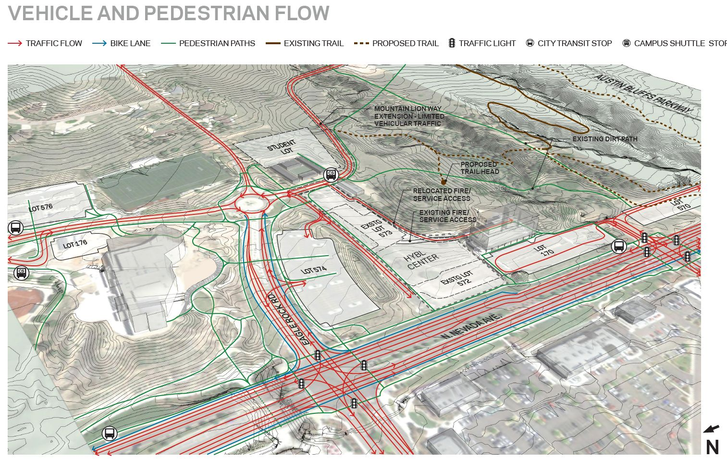

Slide 28
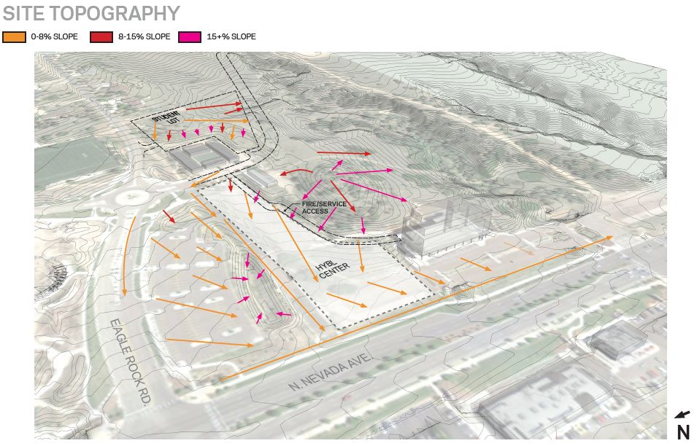

Slide 29
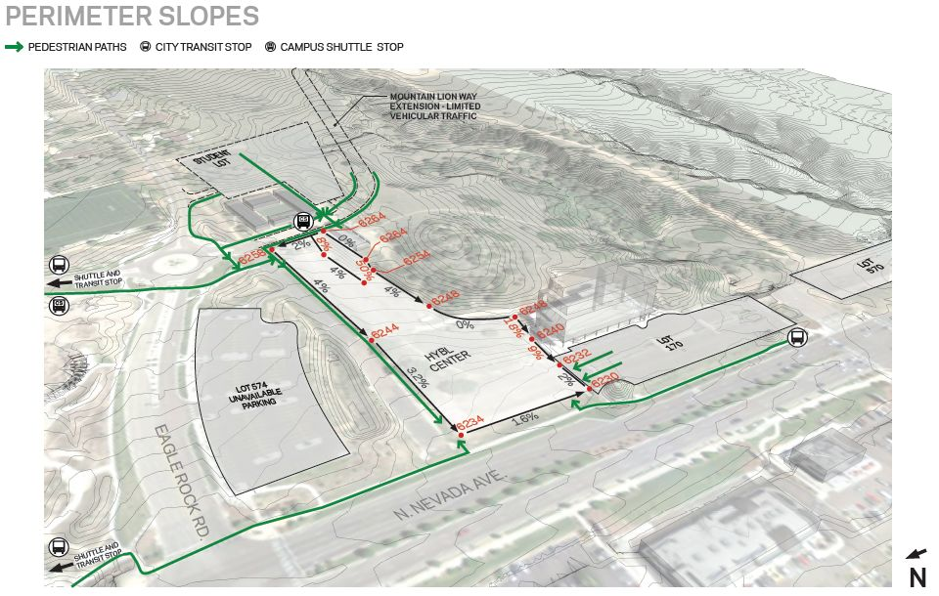

Slide 30
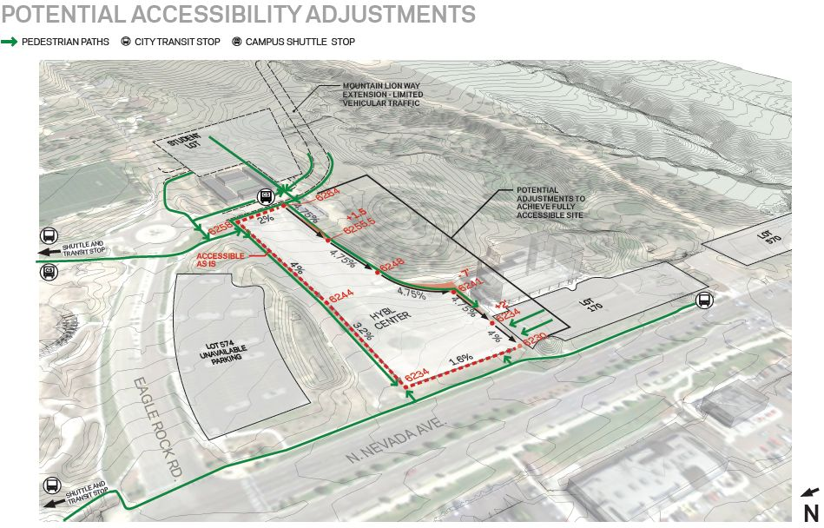

Slide 31
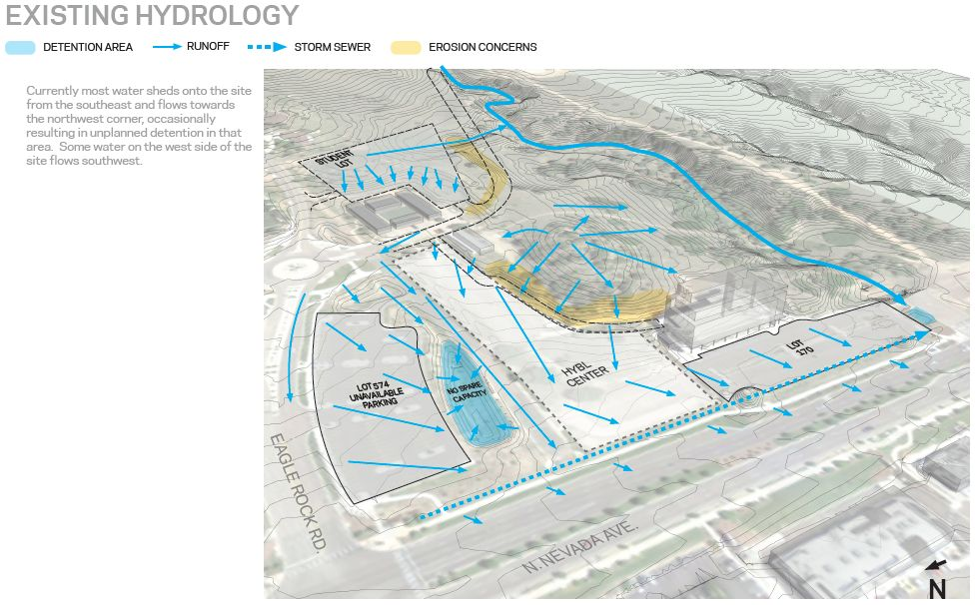

Slide 32
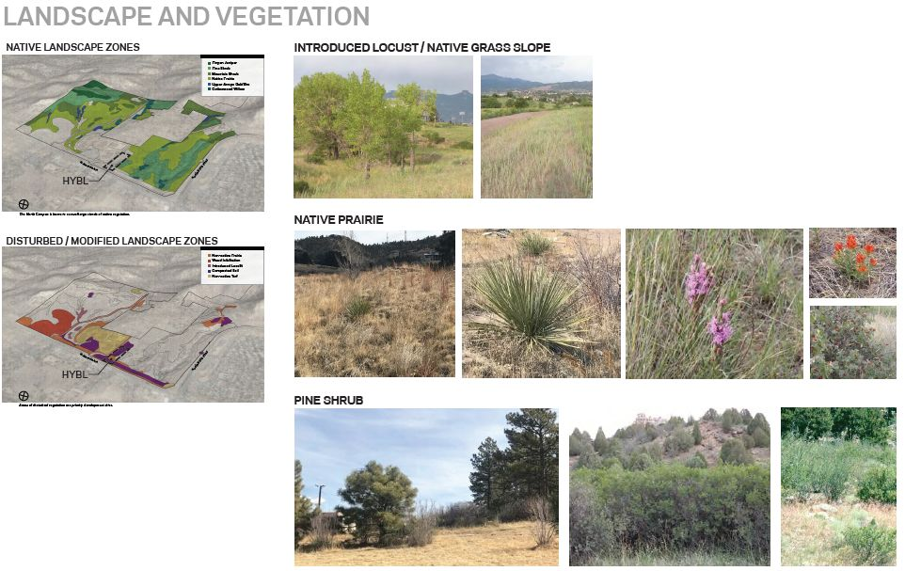

Slide 33
